Slide 2
Content
  Registration
  Revision (For Existing Registered Supplier and Rejected Supplier)
  Renewal

Slide 3
SUPPLIER REGISTRATION

Slide 4
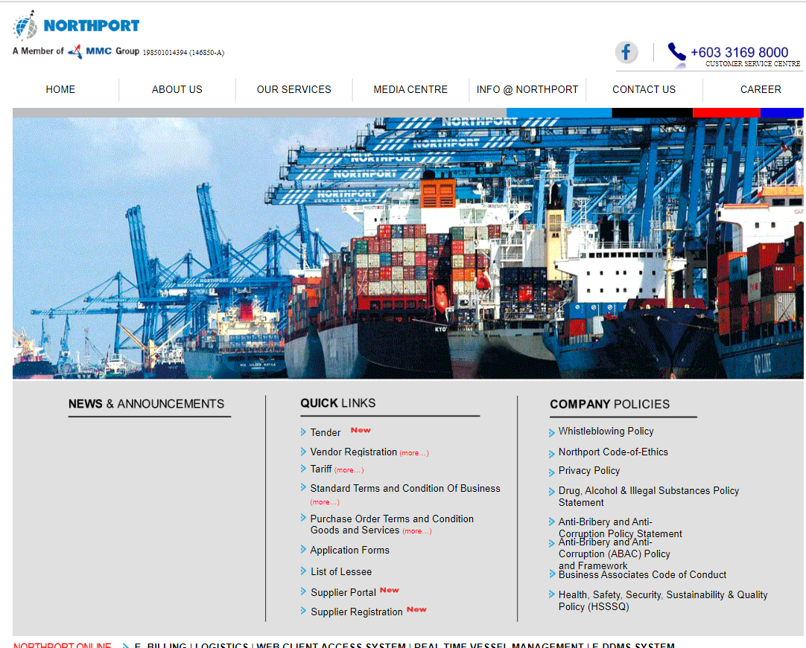
SUPPLIER LOGIN
– Go to MMC-Northport official website (Home (northport.com.my)
– Under Quick Links, click on Supplier Registration. You will be directed to the official Supplier Registration Portal of Northport

Slide 5
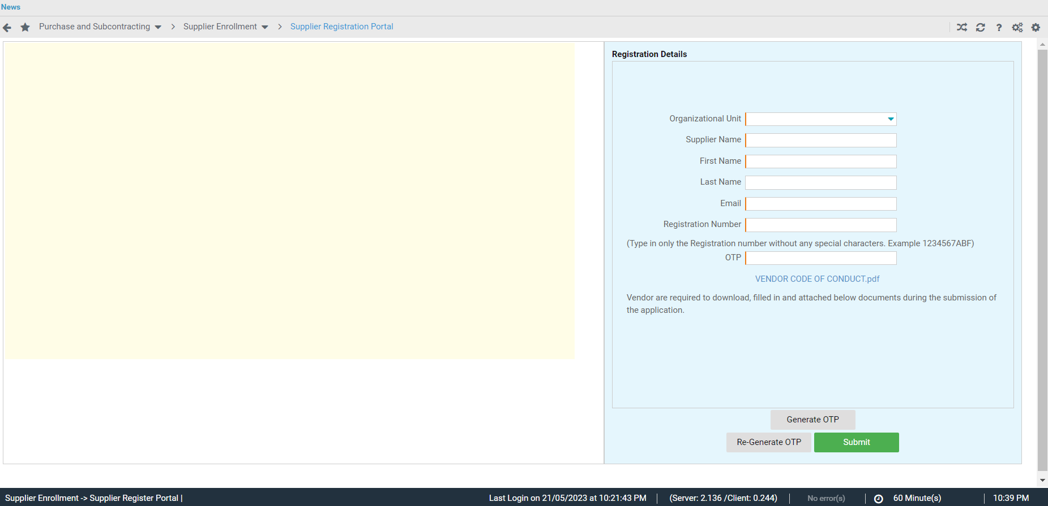
Supplier Registration Portal
- Provide the necessary registration details to proceed with the registration.

Slide 6
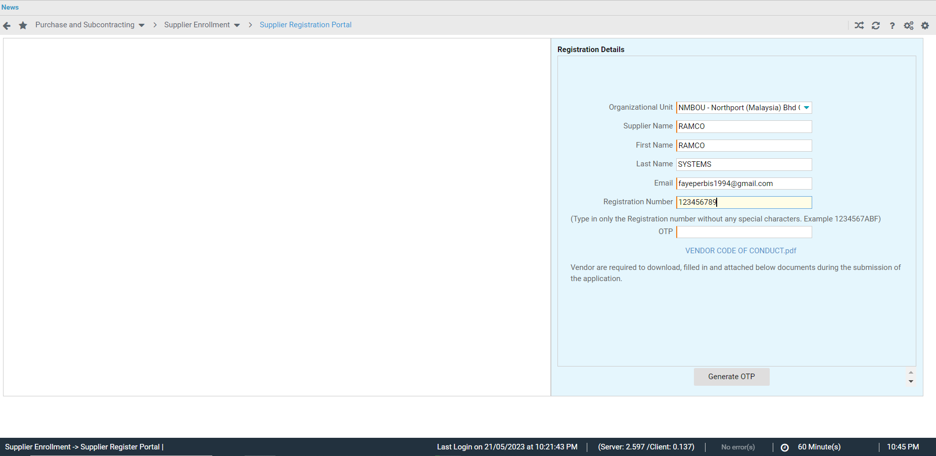
Supplier Registration Portal
- Once Supplier Name, Email and Registration No. is provided, click GENERATE OTP button to receive one time password via the provided email.
Click generate OTP

Slide 7
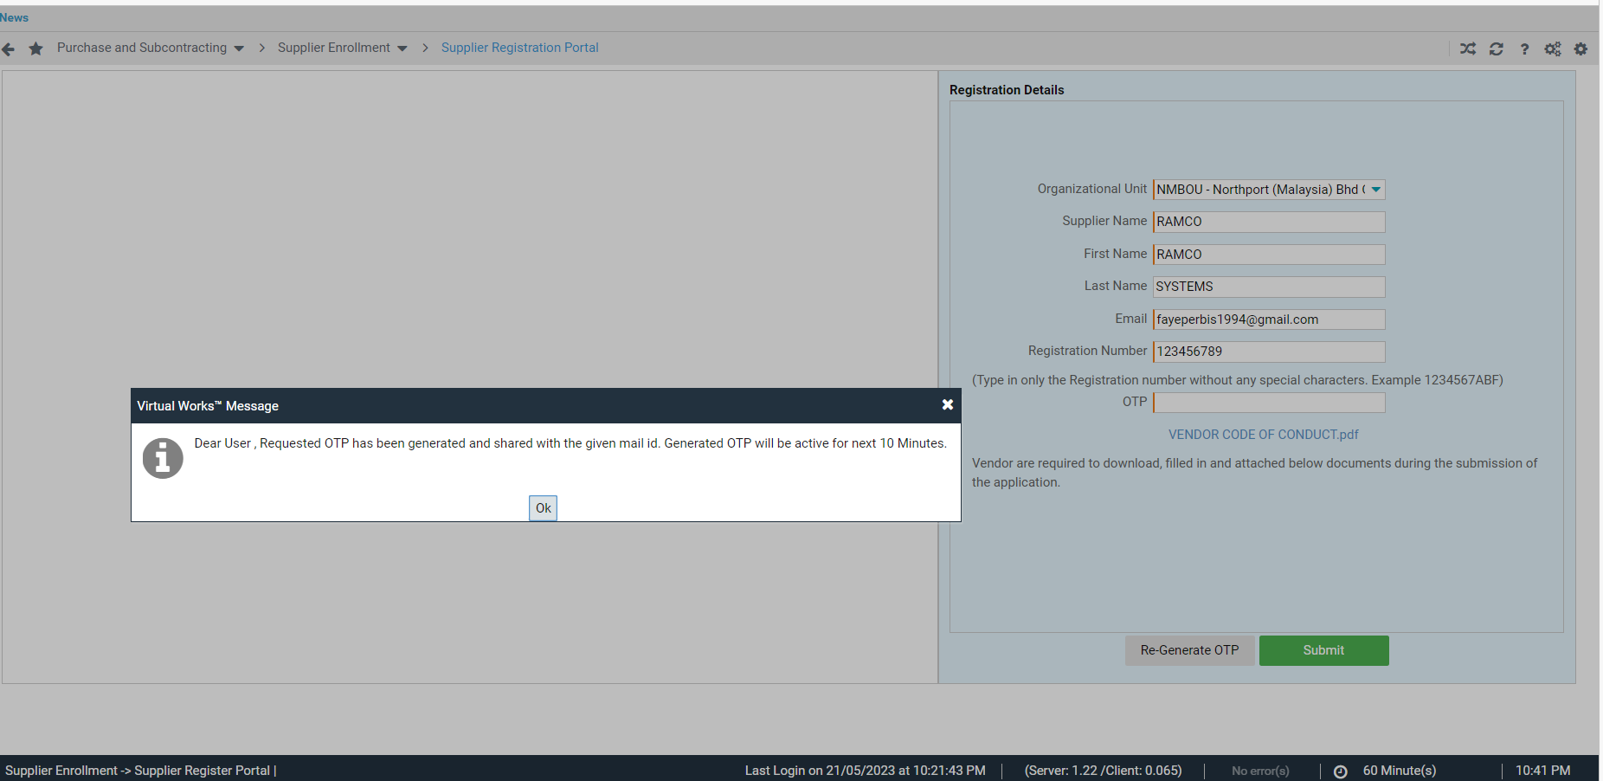
Supplier Registration Portal
- Generated OTP will be active for only 10 minutes. Once lapsed, please click on Re-Generate OTP to receive a new one-time password.

Slide 8
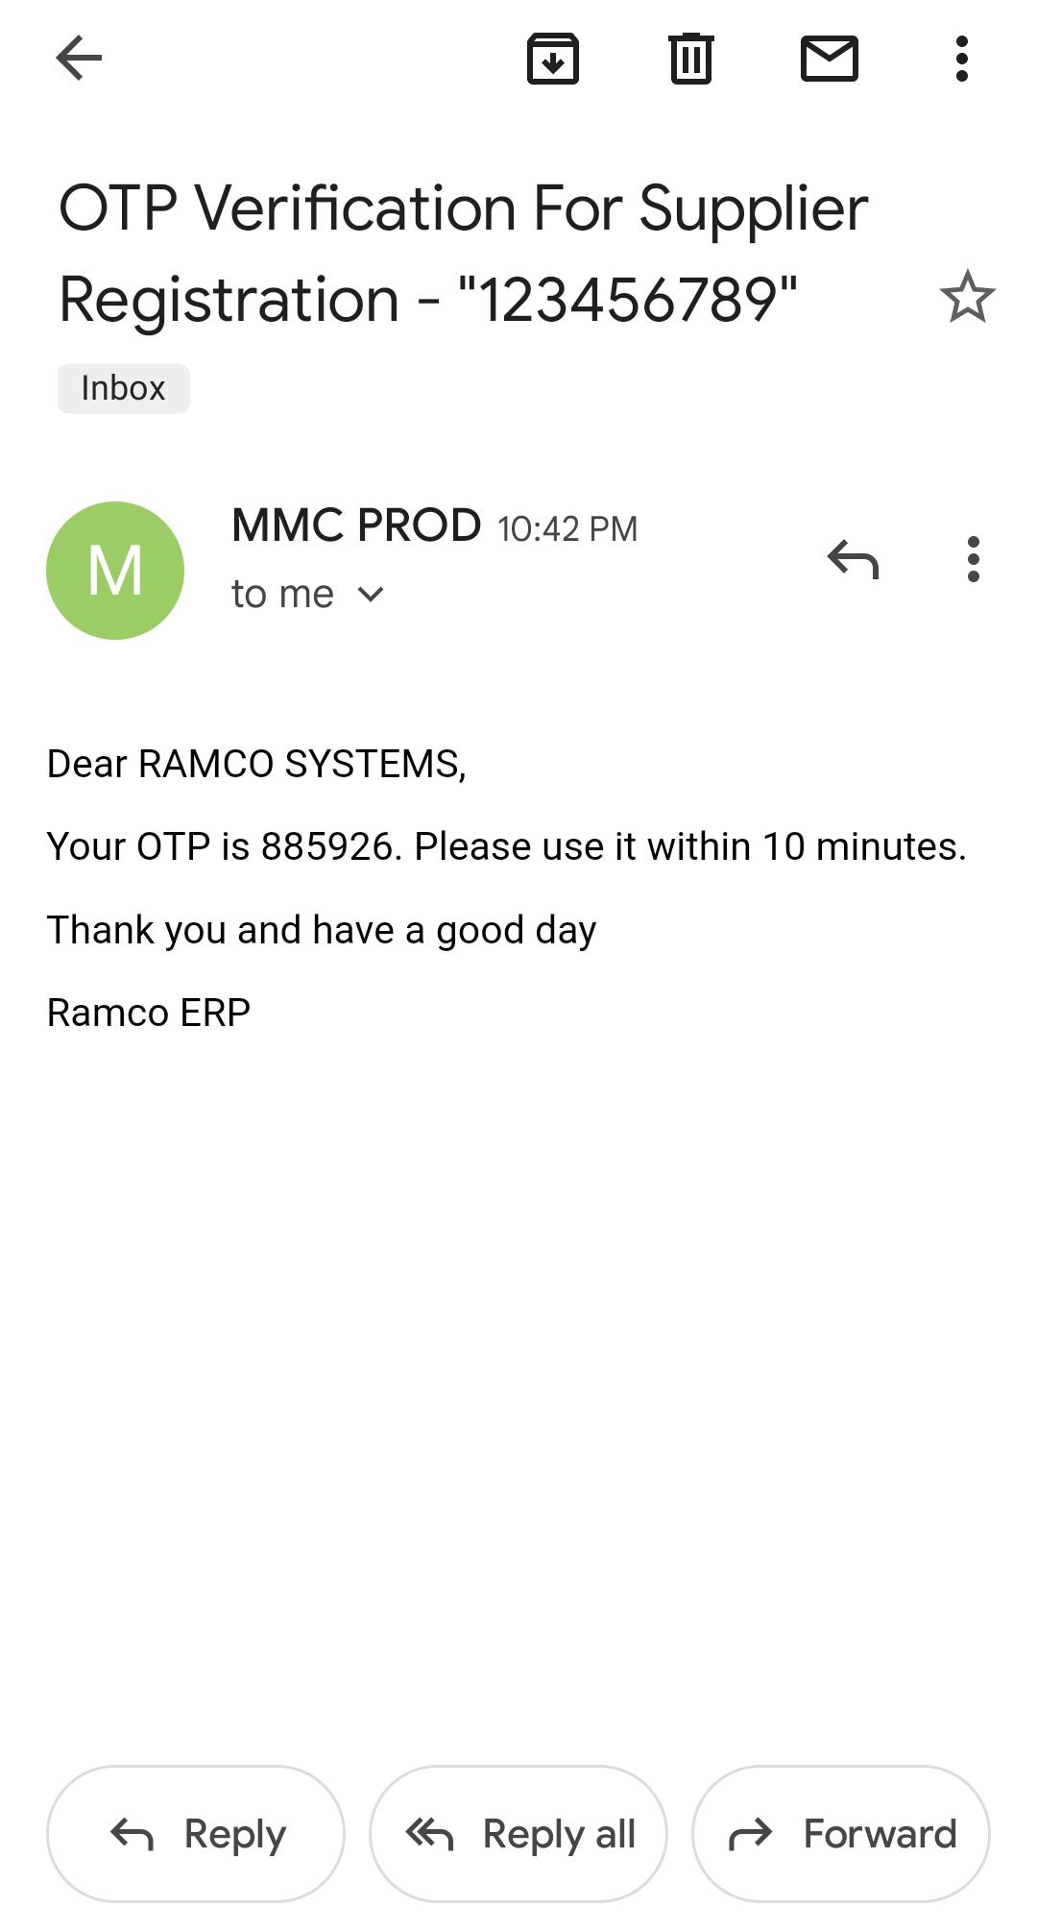
Supplier Registration Portal
- Sample email received by vendor upon generation of One-time Password.
Email with the OTP

Slide 9
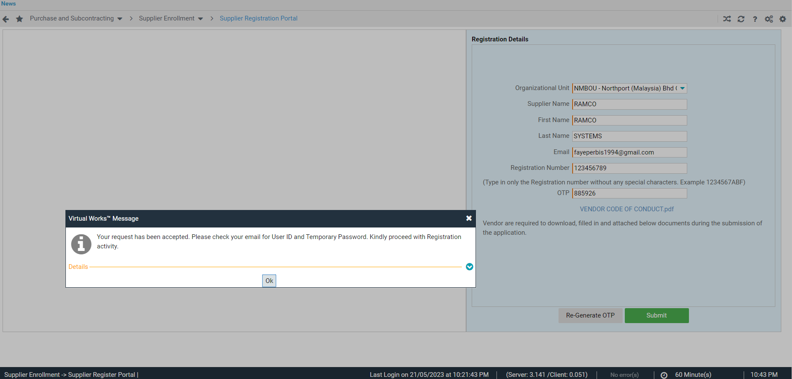
Supplier Registration Portal
Enter the OTP sent via email and click on SUBMIT button.
System will send to the same password the Temporary Login Credentials.

Slide 10
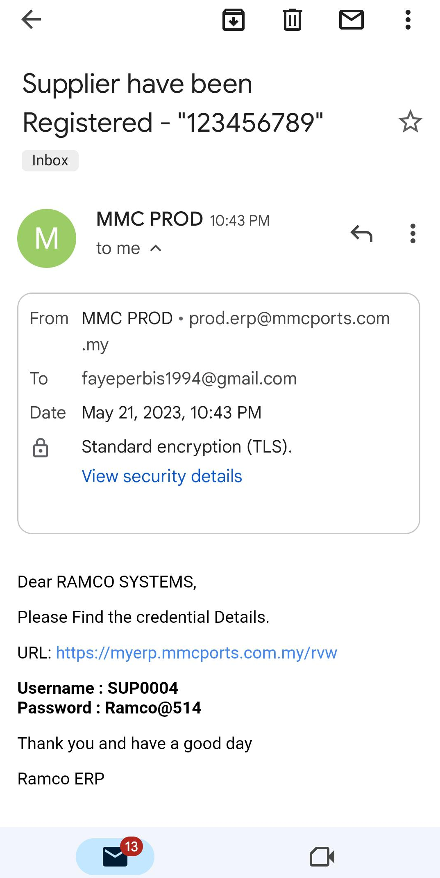
Supplier Registration Portal
Sample email received by vendor upon submission of Registration Details.
Use the URL, Username, and Password to access the Ramco Supplier Registration Portal.
Please note that this is only registration credentials. Once the supplier is approved by MMC Vendor Management, system will provide permanent User Credentials to fully access the Supplier Portal.
Login details received in Email

Slide 11
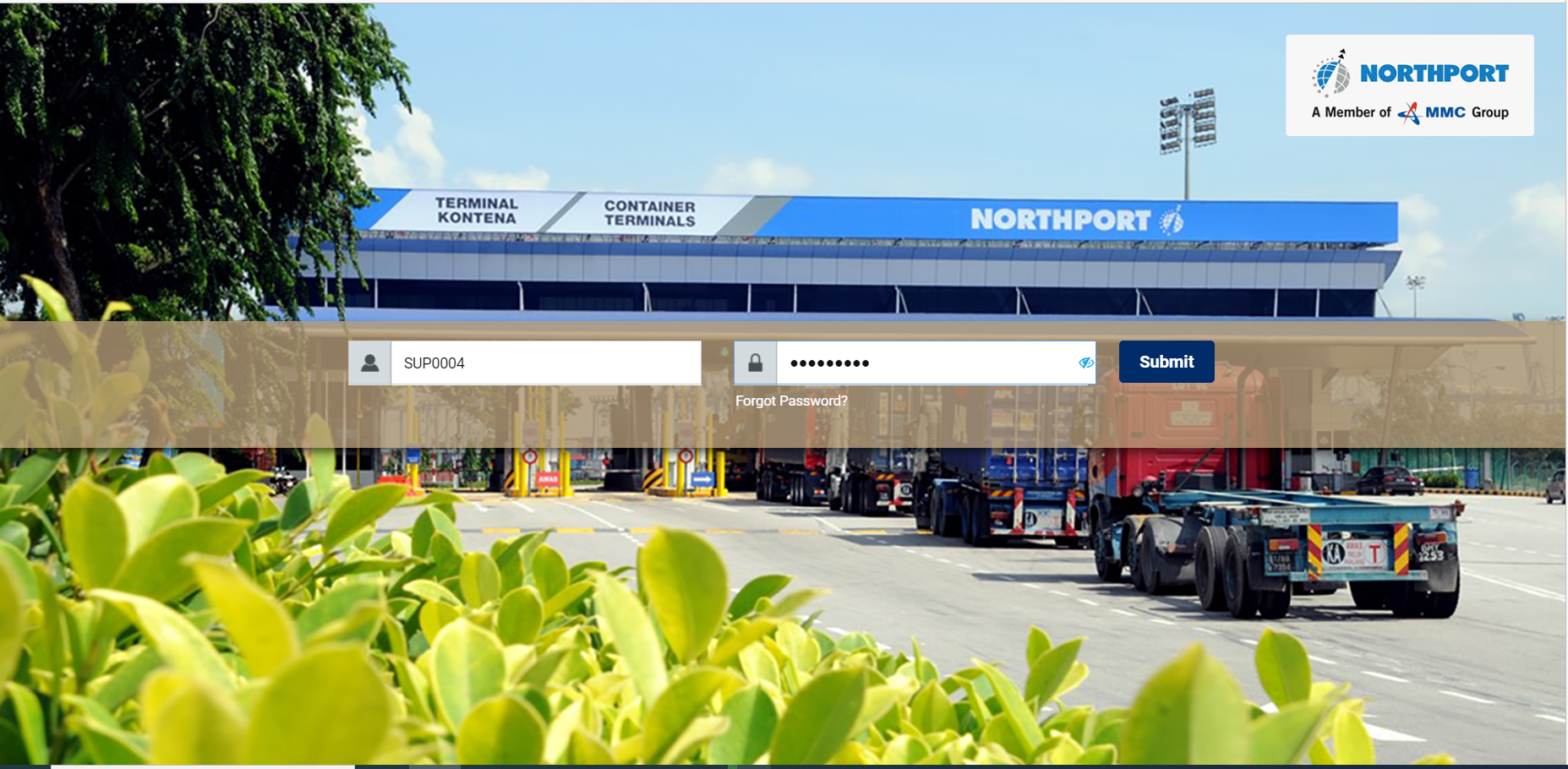
Supplier Login
- Use the URL sent via email to access the Supplier Login screen.
- Enter the Username and Password.
Login with the details

Slide 12
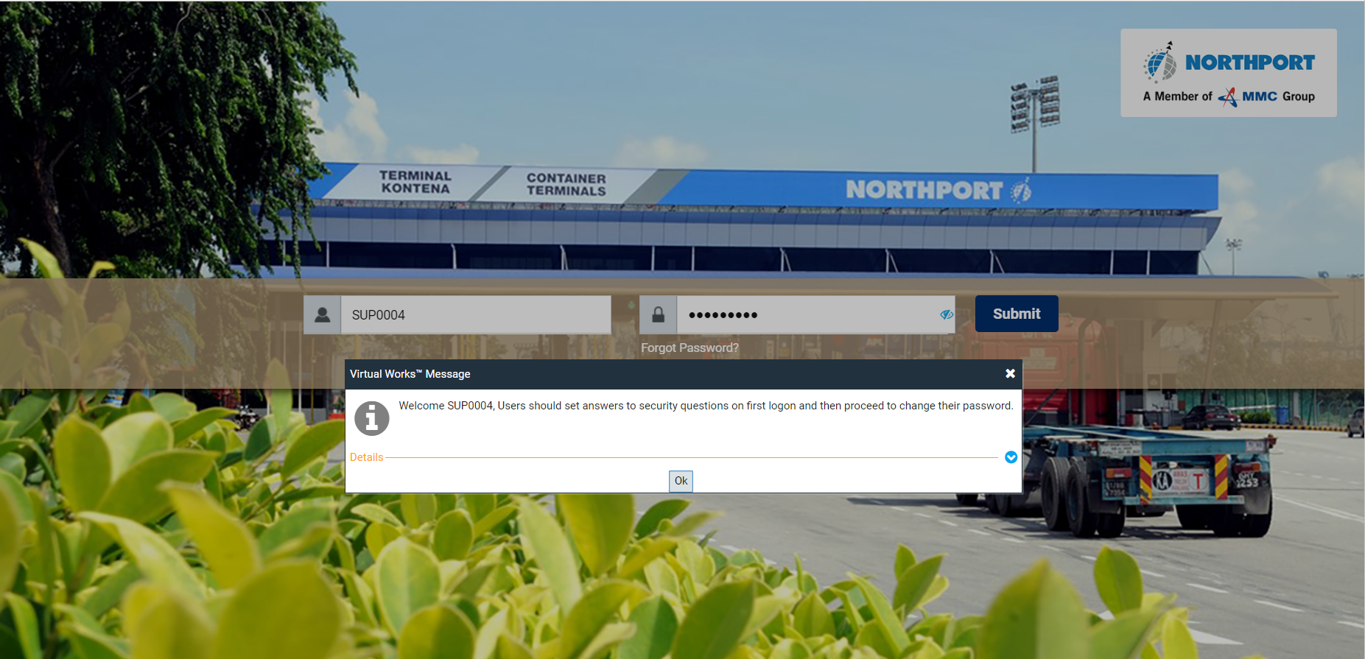
Supplier Login
Click on SUBMIT button to login.
- System will welcome you and ask supplier to answer security questions.

Slide 13
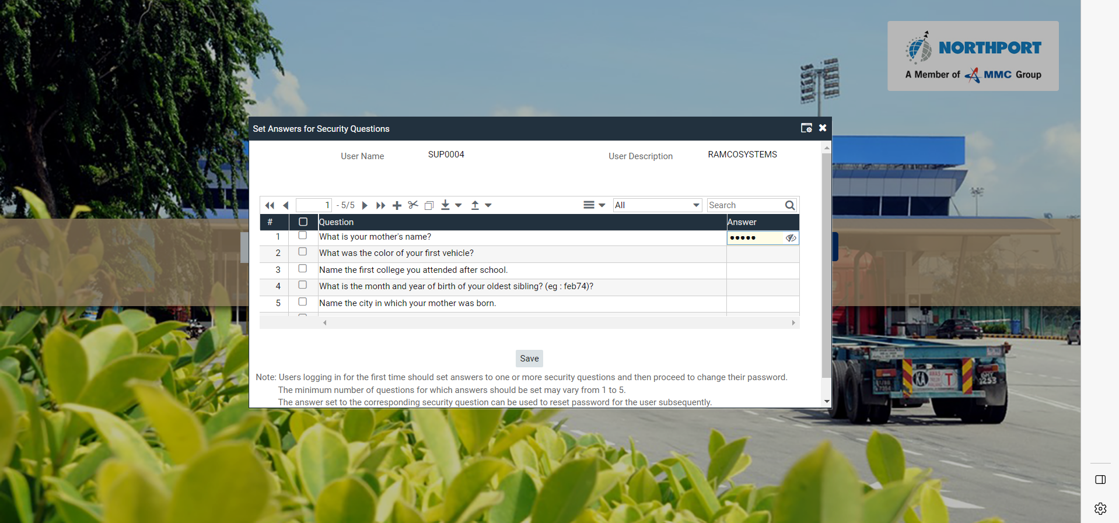
Supplier Login
Set of Security Questions will appear. Please answer at least one to proceed.
- Once answer is provided, click on SAVE button.

Slide 14
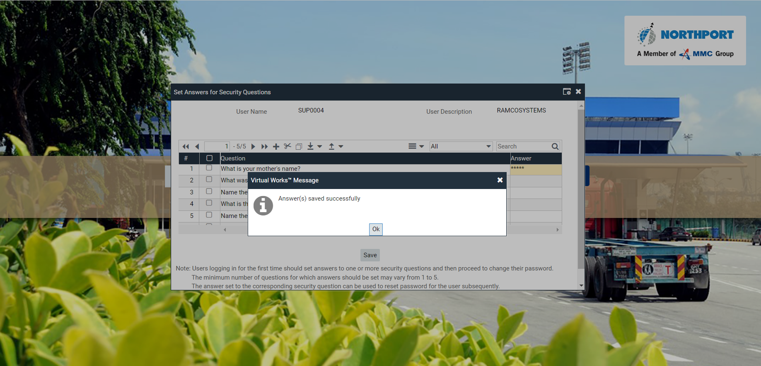
Supplier Login
Click on OK and Reset Password screen will launch.

Slide 15
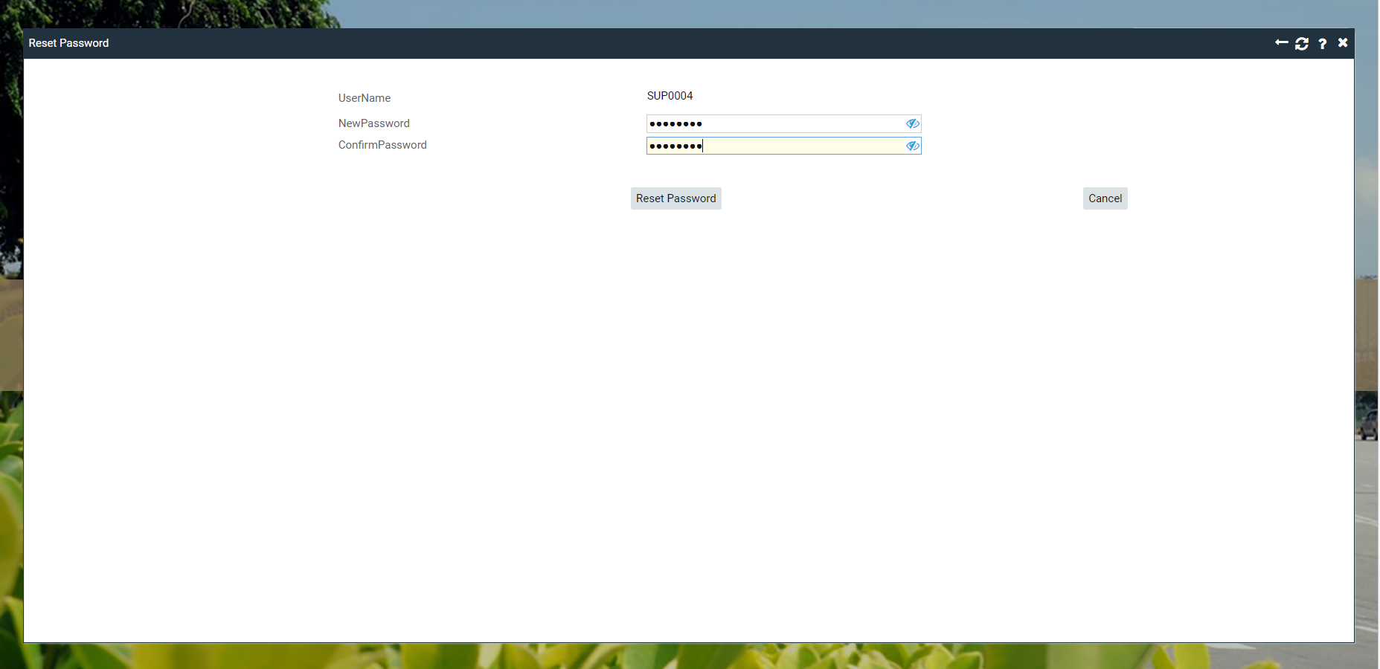
Supplier Login
Reset of Password is required for security purposes. Password minimum length and controls are set depending on the company policy.
Change the password for security

Slide 16
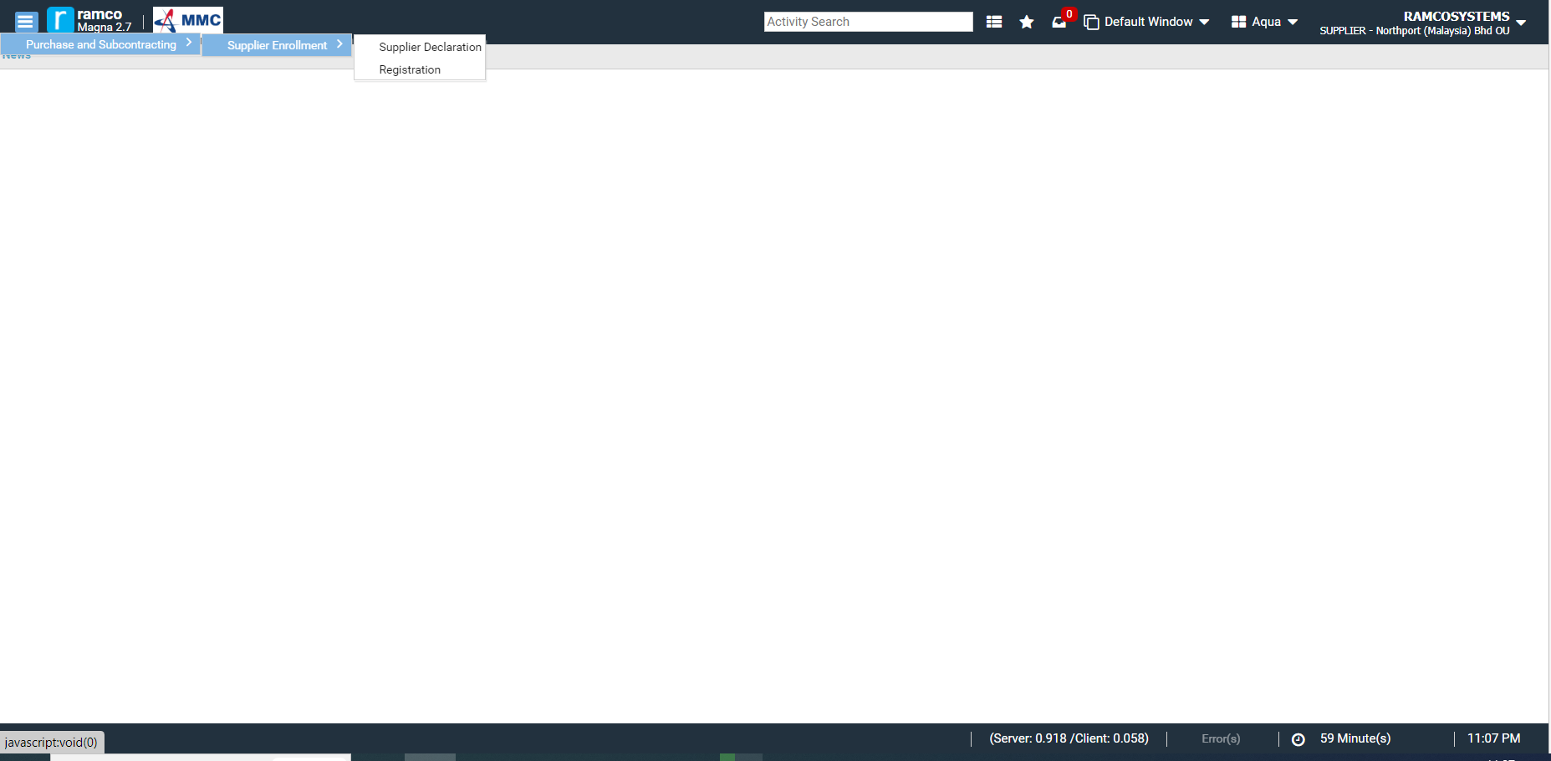
Supplier Declaration
After reset of Password, user will be directed on the Ramco Home Page.
In the left pane, click on Purchase and Subcontracting > Supplier Enrollment and select SUPPLIER DECLARATION activity.
System Flow

Slide 17
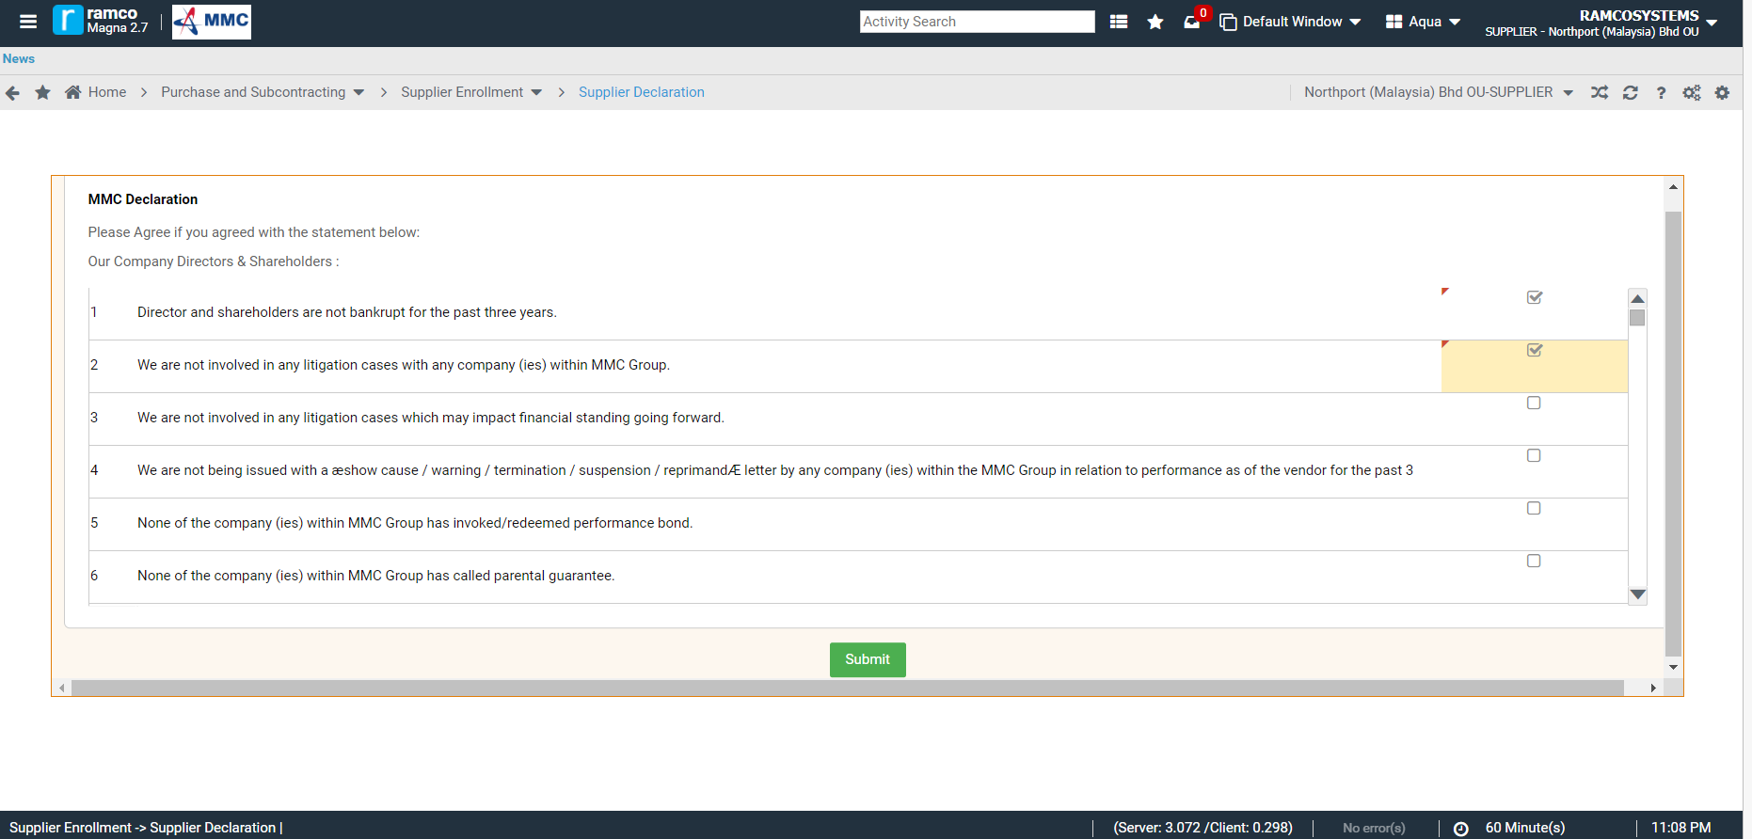
Supplier Declaration
MMC Declaration screen will launch.
Please click the corresponding checkbox if you agree for each of the statement.
Acknowledge the Declaration

Slide 18
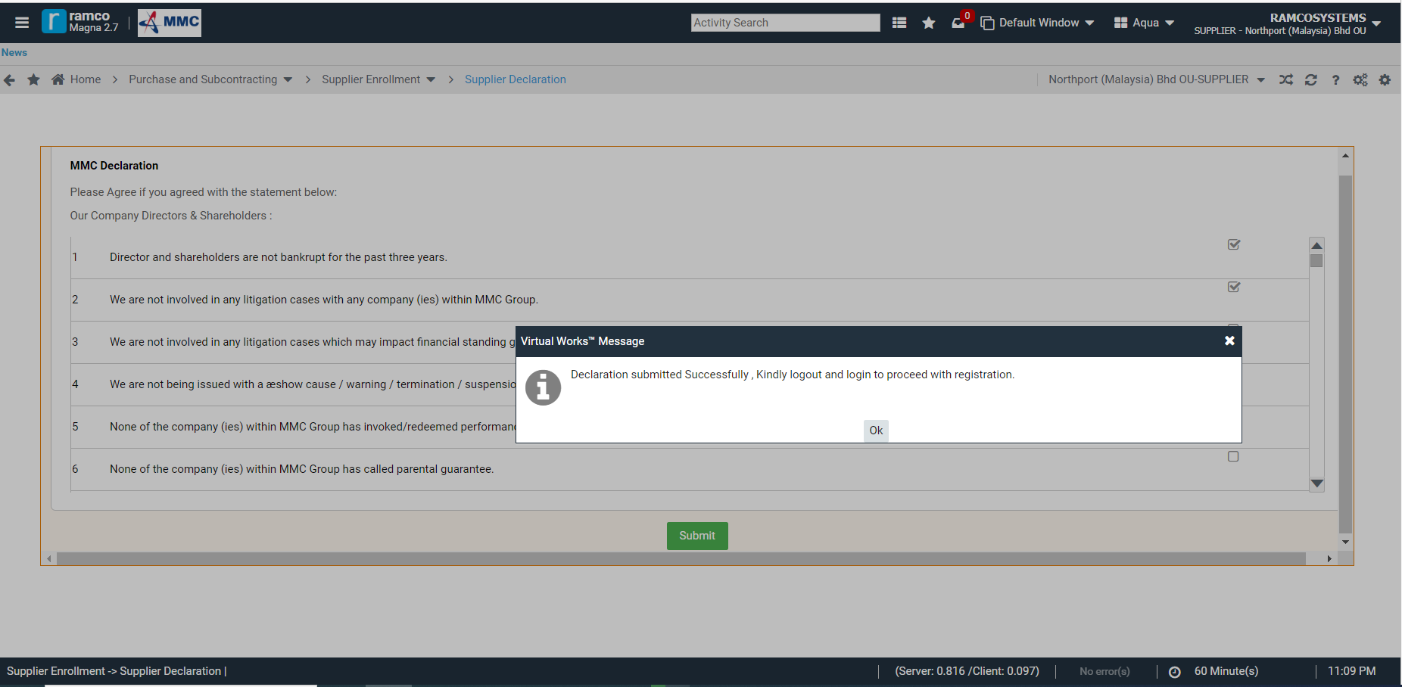
Supplier Declaration
Once all MMC Declaration statements are carefully responded, please click on SUBMIT button.
System will ask you to Logout and Login to proceed with the registration.

Slide 19
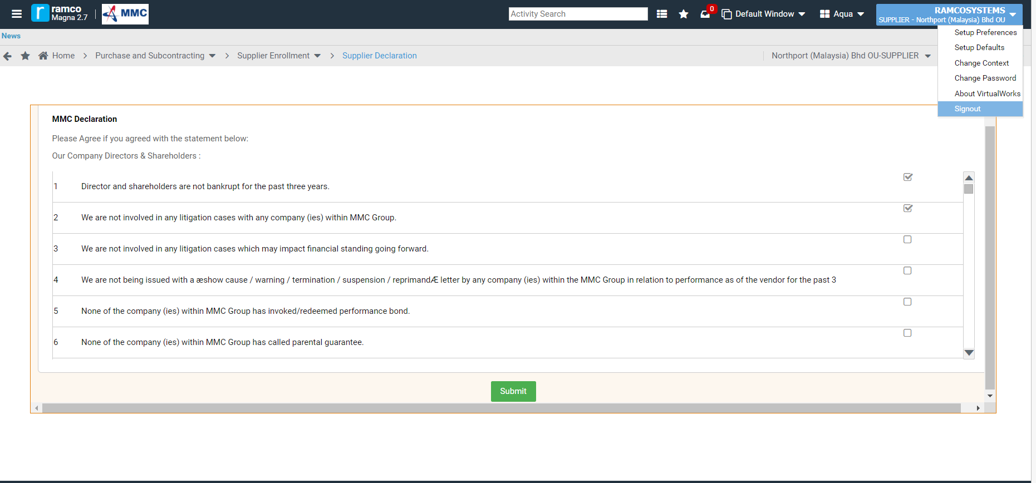
Supplier Declaration
To Logout, kindly click on the Supplier Name on the upper right corner of the screen.
Then click on SIGNOUT.

Slide 20
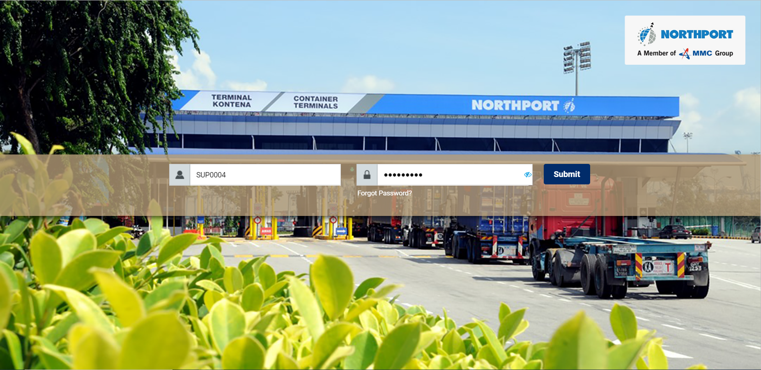
Supplier Login
- Login into the system by entering the Username and the new Password.
Login with the Username & new Password

Slide 21
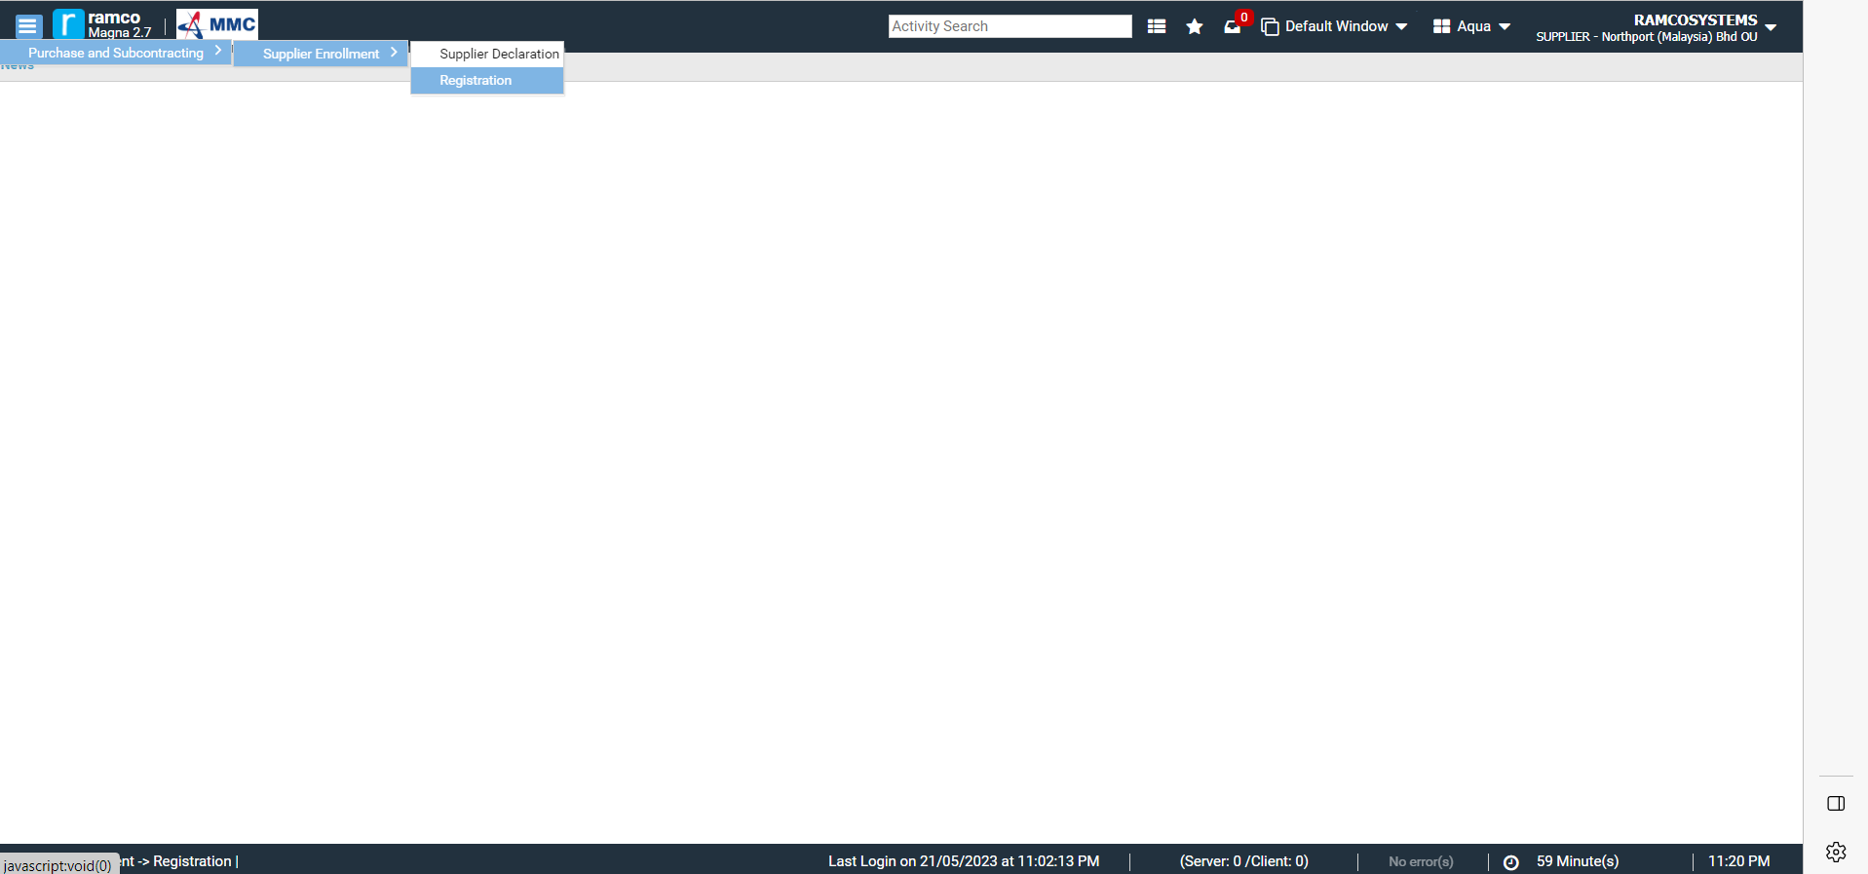
Supplier Registration
After login, user will be directed on the Ramco Home Page.
In the left pane, click on Purchase and Subcontracting > Supplier Enrollment and select REGISTRATION activity.
System Flow

Slide 22
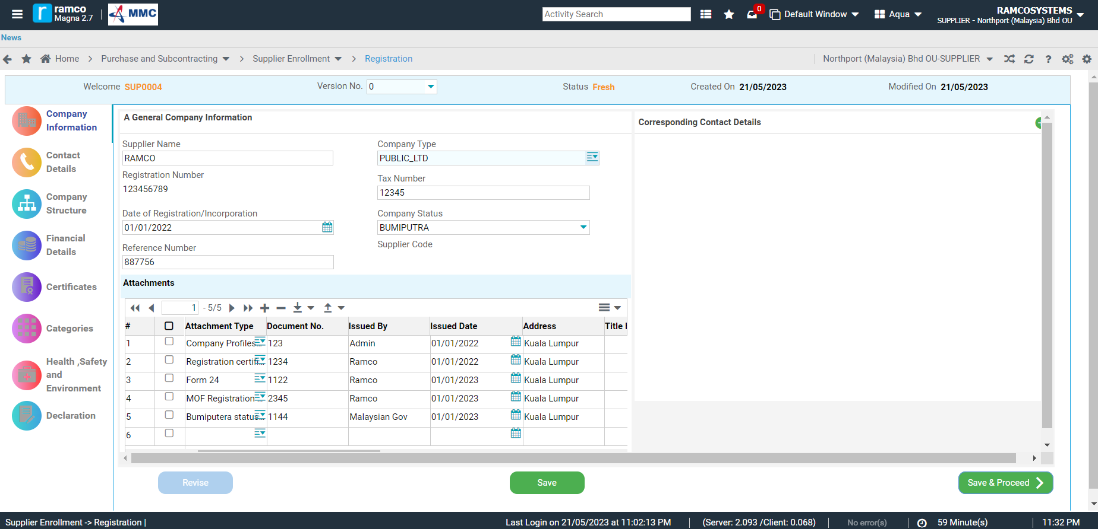
Supplier Registration
Supplier Registration screen will launch.
Enter General Company Information and required Attachments.
Details under different blocks need to be filled to proceed

Slide 23
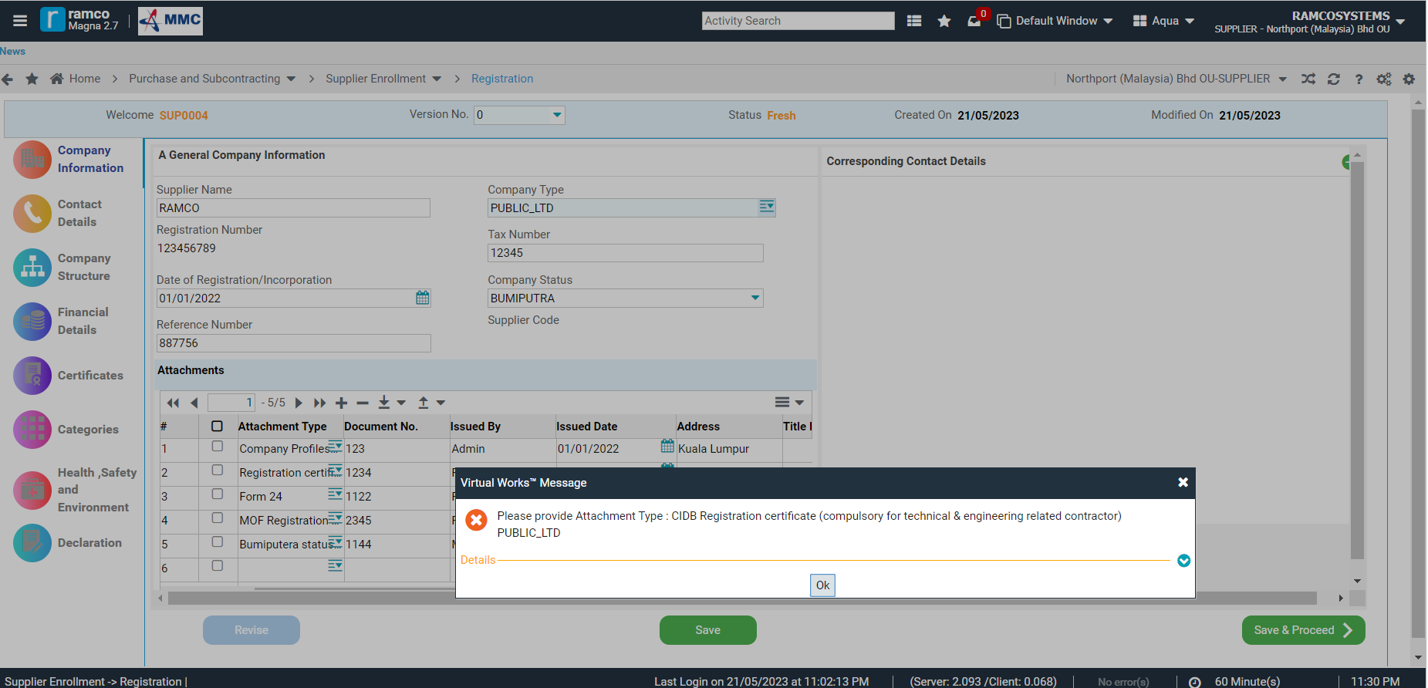
Supplier Registration
Click on SAVE button to save entered information.
When clicking SAVE & PROCEED, system validation for completion of mandatory details in each block will appear.
System validation for completion of the mandatory details in each block

Slide 24
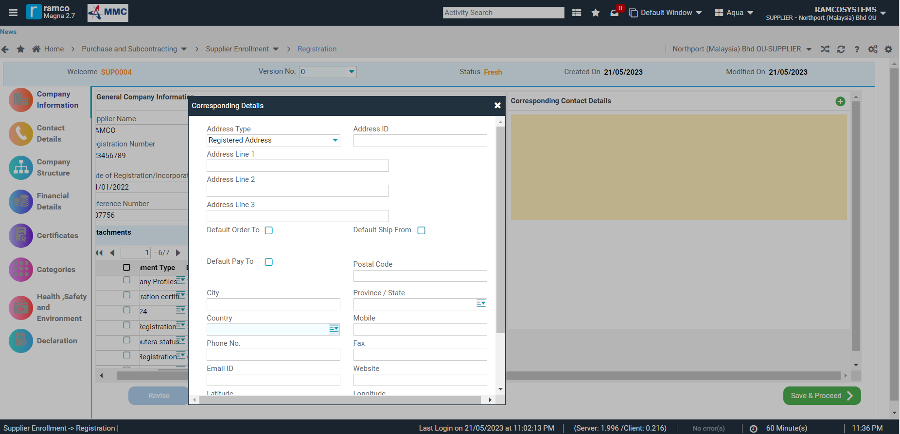
Supplier Registration
Click on + sign to add the Corresponding Contact Details of the vendor.
Fill in the details.
Fill in the details

Slide 25
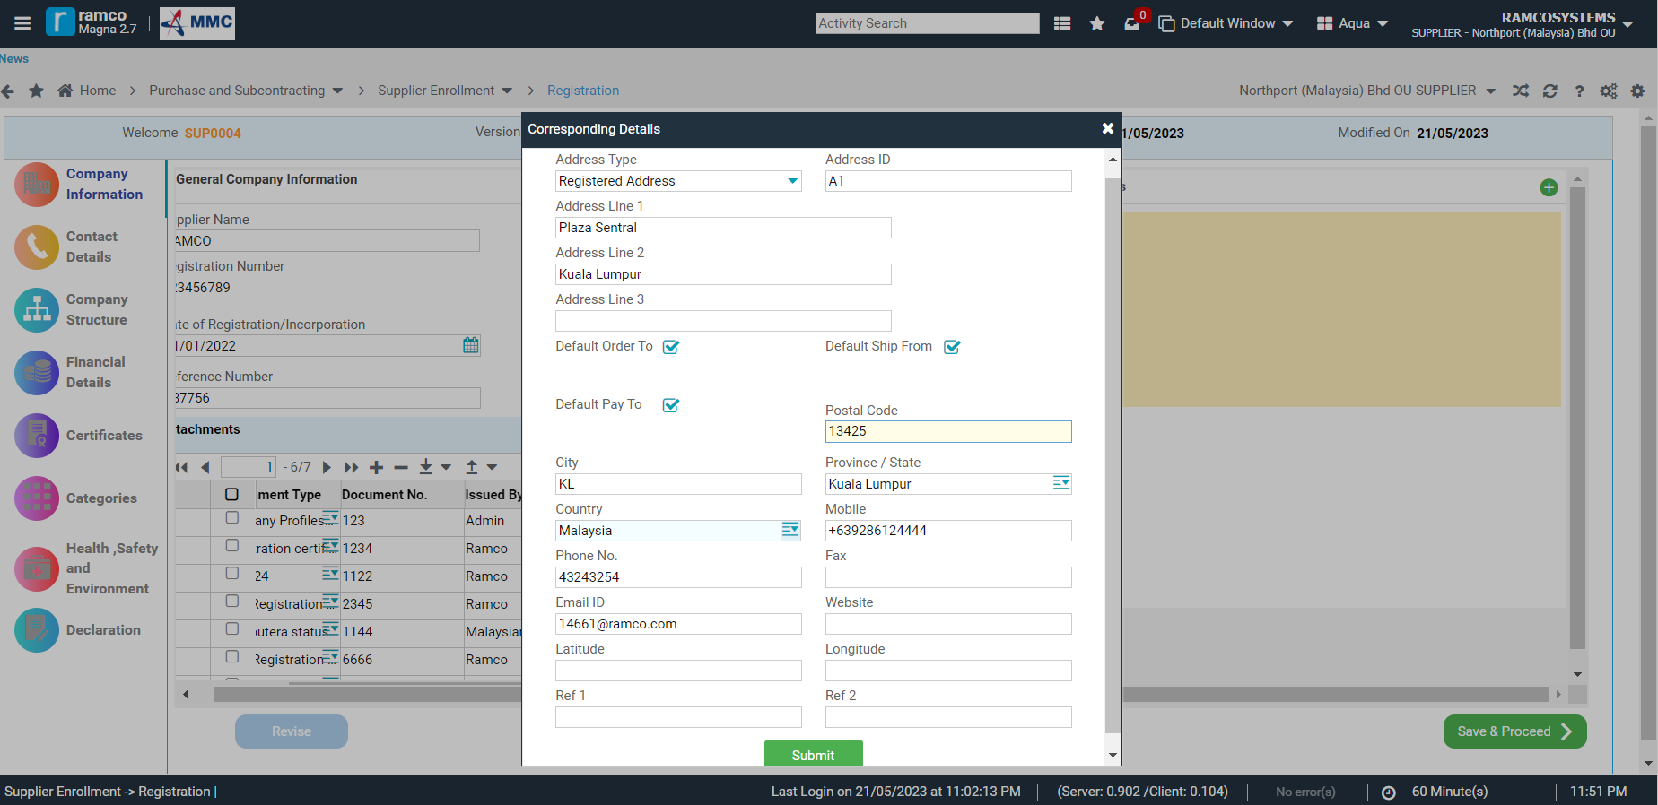
Supplier Registration
At least one contact details of the vendor should be tagged as Default Order To, Default Pay To and Default Ship From.
Once necessary data are entered, click on SUBMIT button.

Slide 26
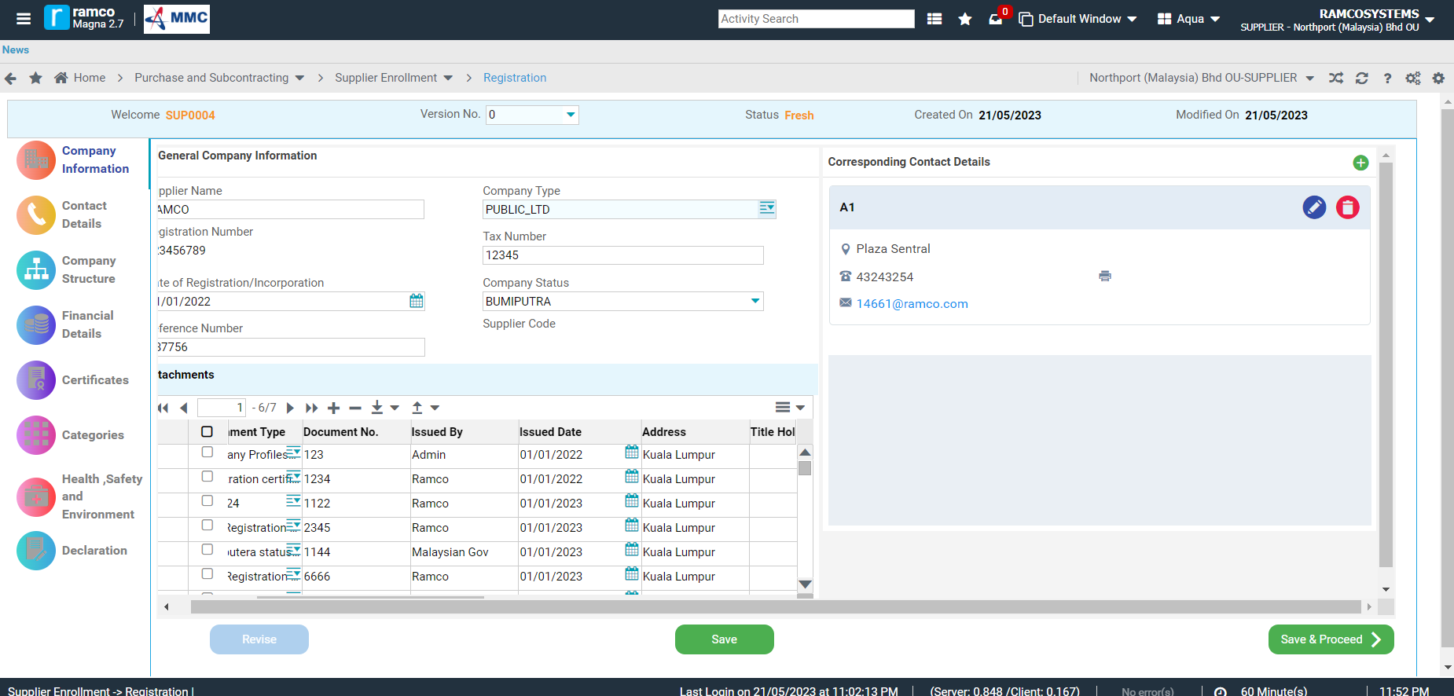
Supplier Registration
Once General Company Information, Attachments and Corresponding Contact Details are entered, click on SAVE & PROCEED button to proceed.

Slide 27
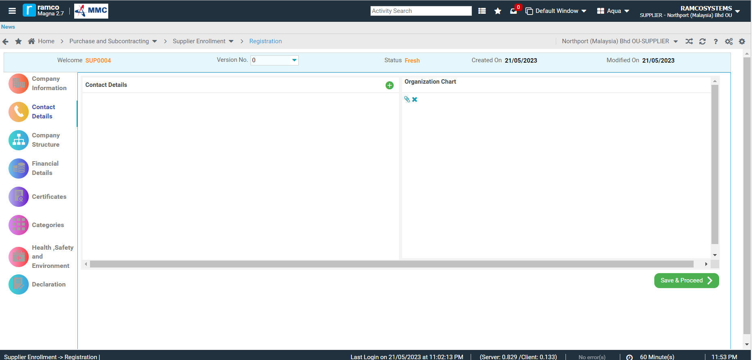
Supplier Registration
In Contact Details, click on + sign to add the Contact Details of the vendor.
Contact details & Org Chart need to be filled

Slide 28
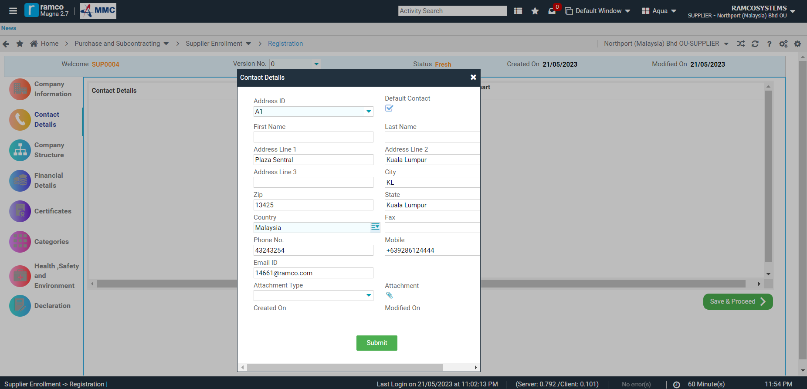
Supplier Registration
  In Contact Details, at least one Contact Person should be set as Default.
  Fill in all necessary contact details.

Slide 29
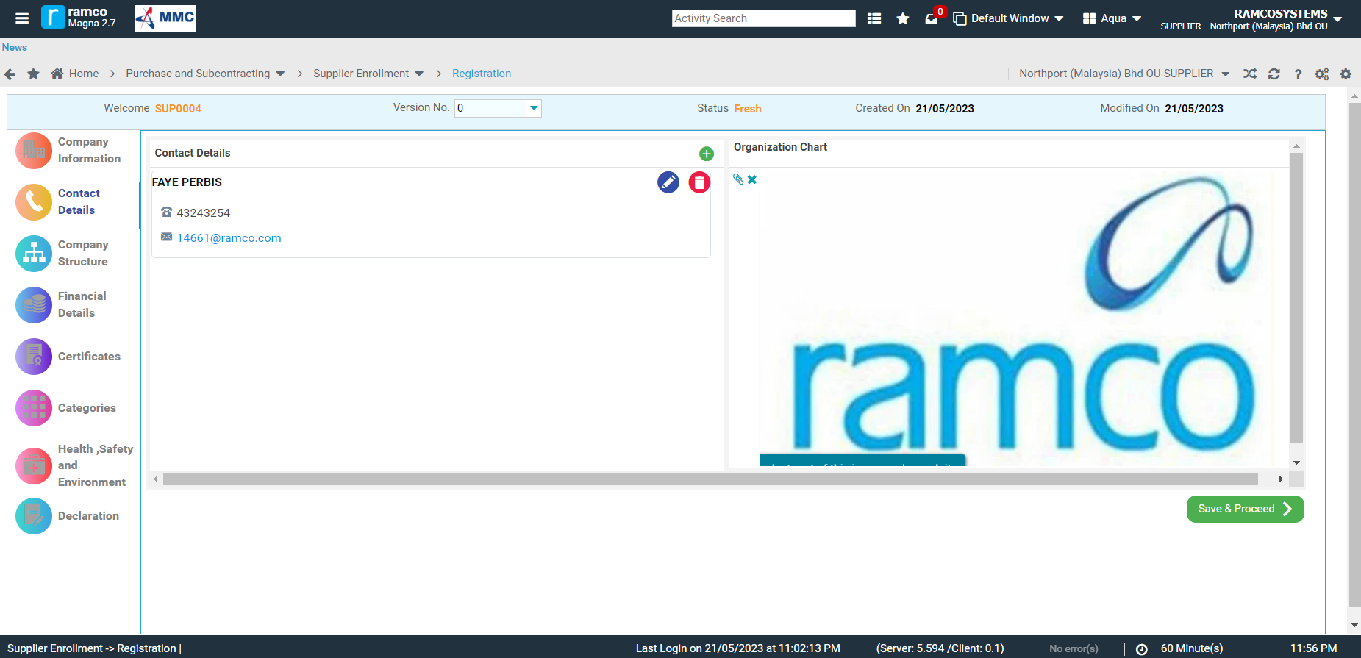
Supplier Registration
Attach Organization Chart (image format only), by clicking on the Attach icon to select/browse file to attach.
Click on SAVE & PROCEED.
Note: If Organization Chart is in PDF or any format other than Image formats, please attach the Org. Chart in Company Information-Attachments.

Slide 30
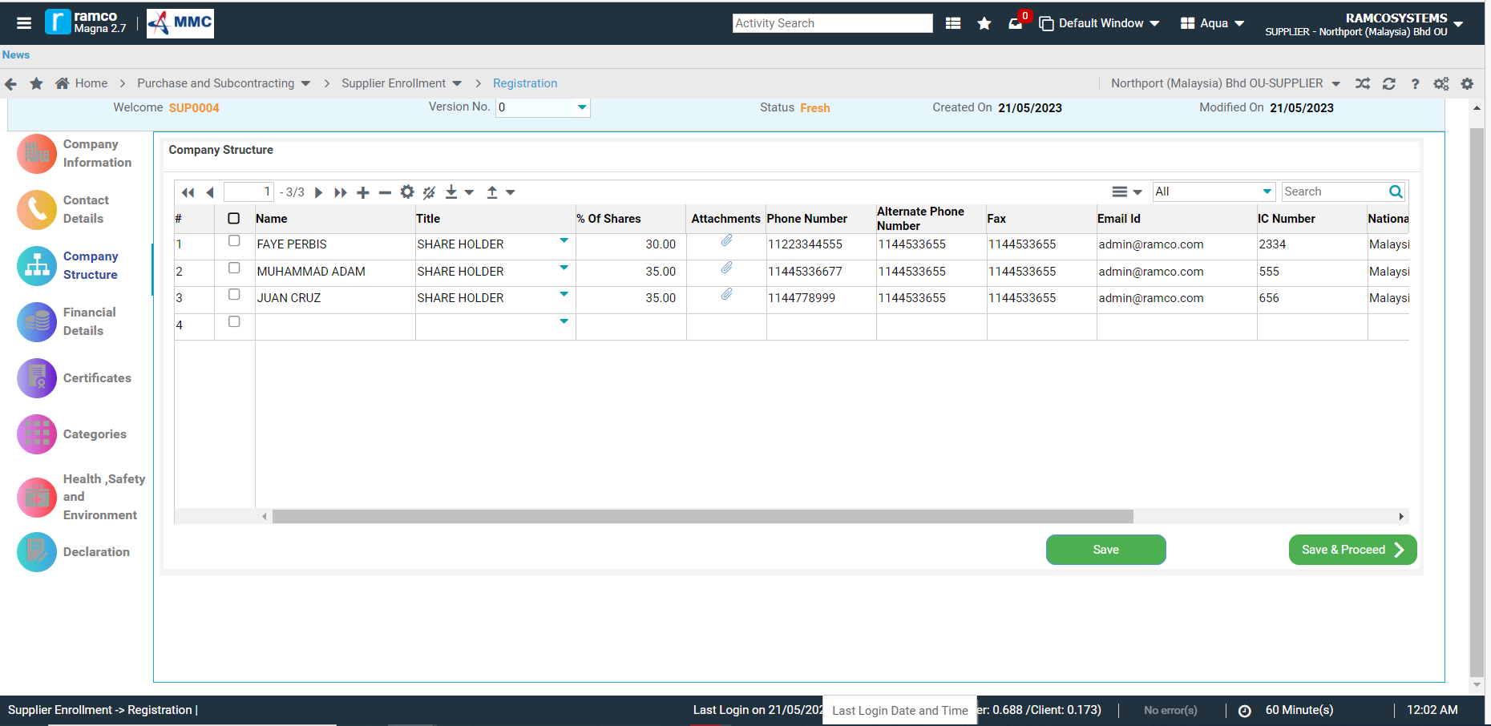
Supplier Registration
In the Company Structure, please enter the details per name.
Click on SAVE to save the details and attachments.
Once details are complete, please click on SAVE & PROCEED to continue.
Company structure details under multiple title

Slide 31
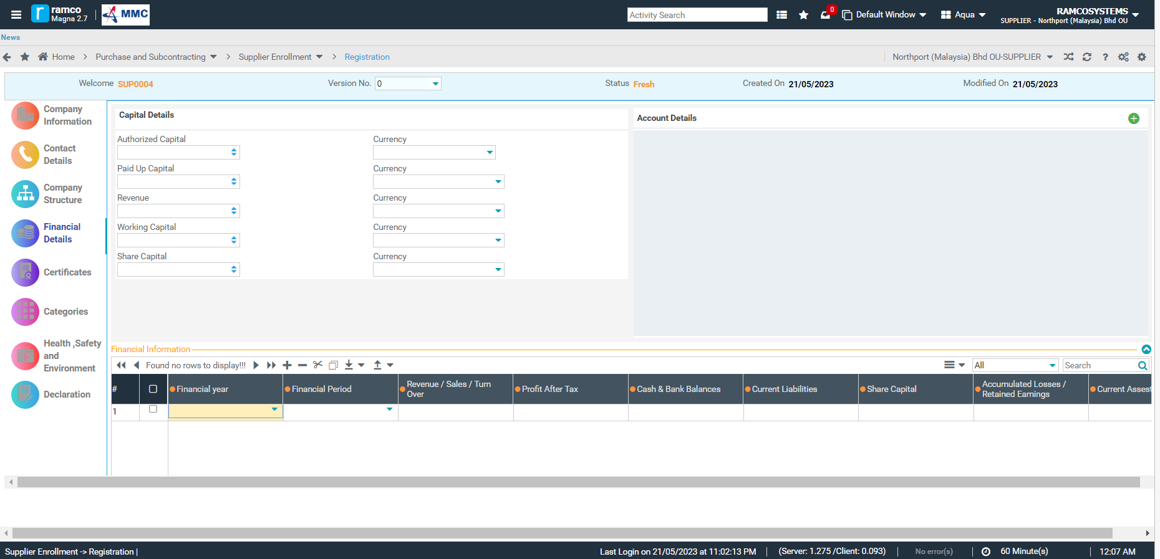
Supplier Registration
In the Finance Details, please enter the details applicable to the supplier type.
Account Details should also be supplied as requirement by Finance.
Details to be filled based on the type of supplier

Slide 32
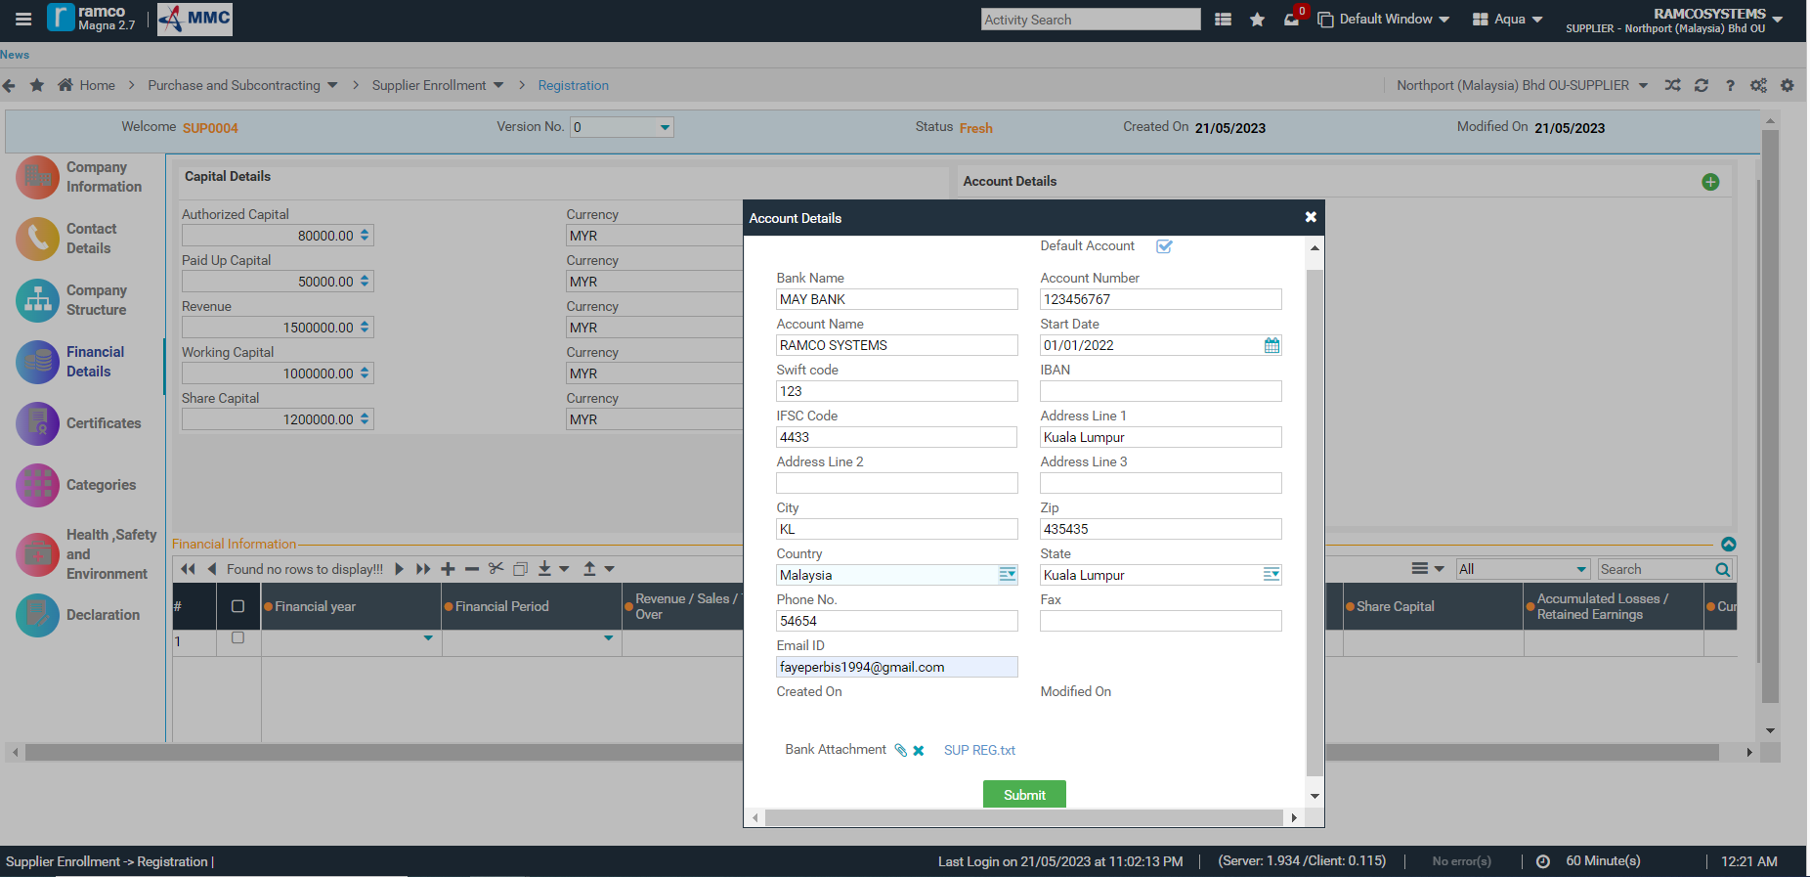
Supplier Registration
At least one account detail should be set as Default.
Bank Statement is a required attachment when entering the Account details.

Slide 33
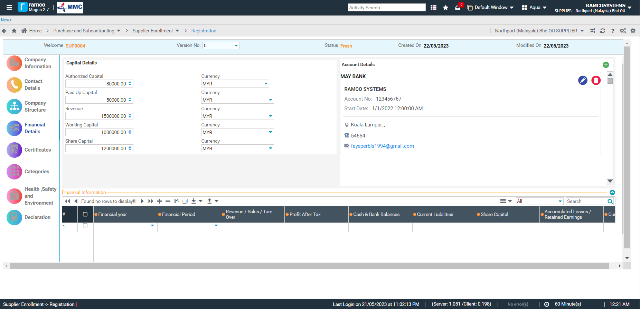
Supplier Registration
Financial Information should be entered also based on the Financial Statements of the supplier.
Financial Statements shall be attached also in the attachment column.

Slide 34
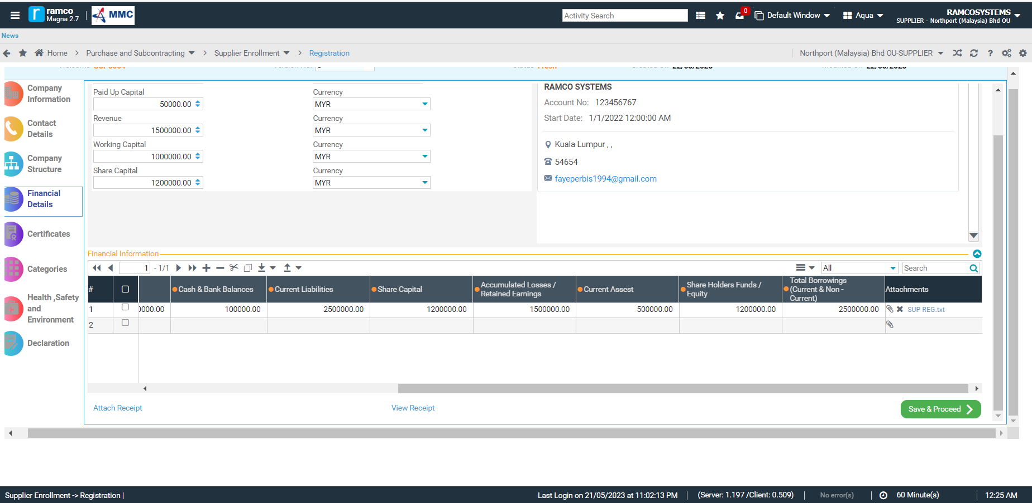
Supplier Registration
Once Capital details, Account Details and Financial Information are entered, click on SAVE & PROCEED to continue.

Slide 35
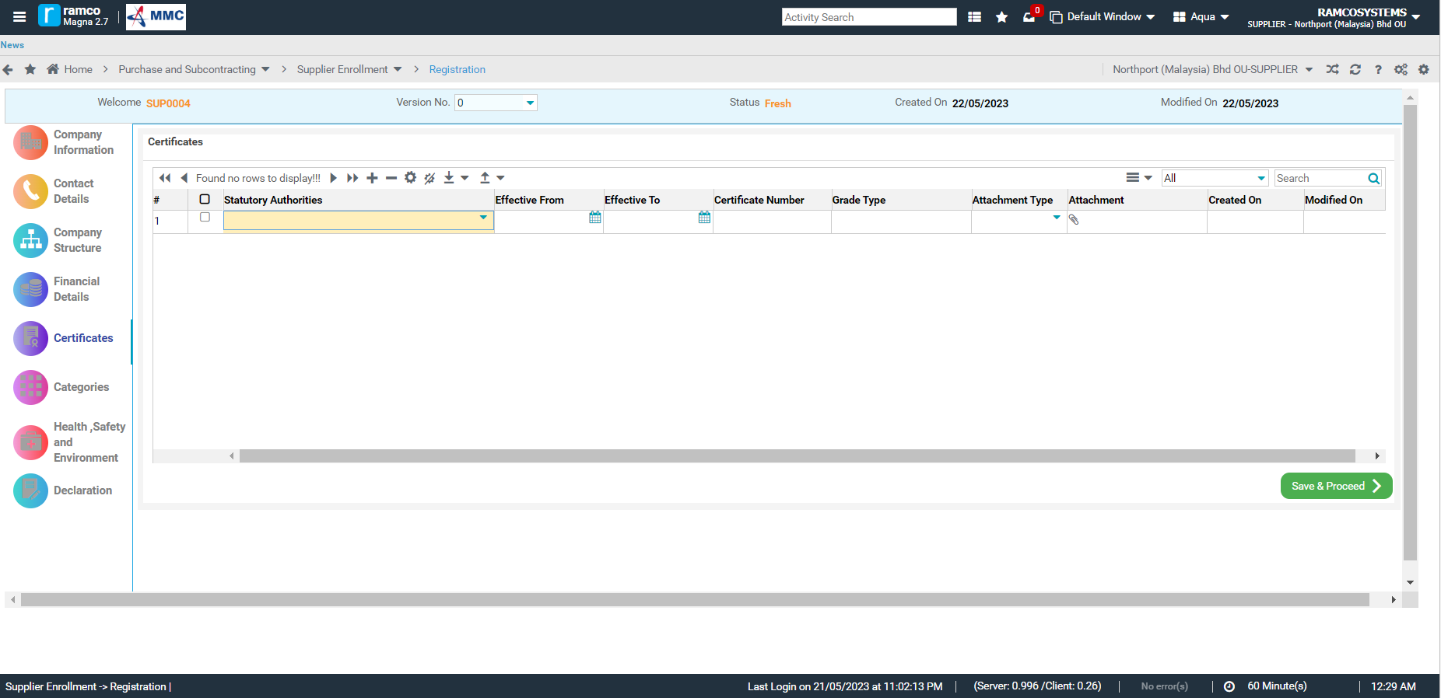
Supplier Registration
Certificates issued by Statutory authorities should be entered and attached also depending on the supplier type and services/products offered.
Certificates details to be filled

Slide 36
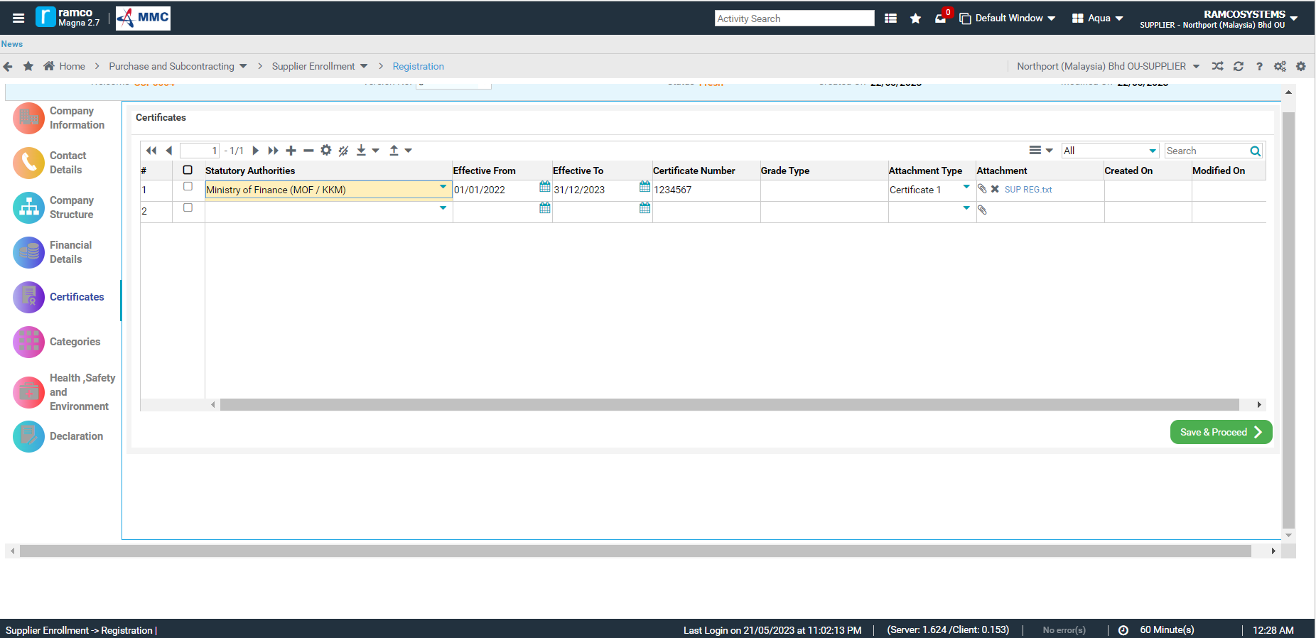
Supplier Registration
Once required Certificates are attached, click on SAVE & PROCEED to continue.

Slide 37
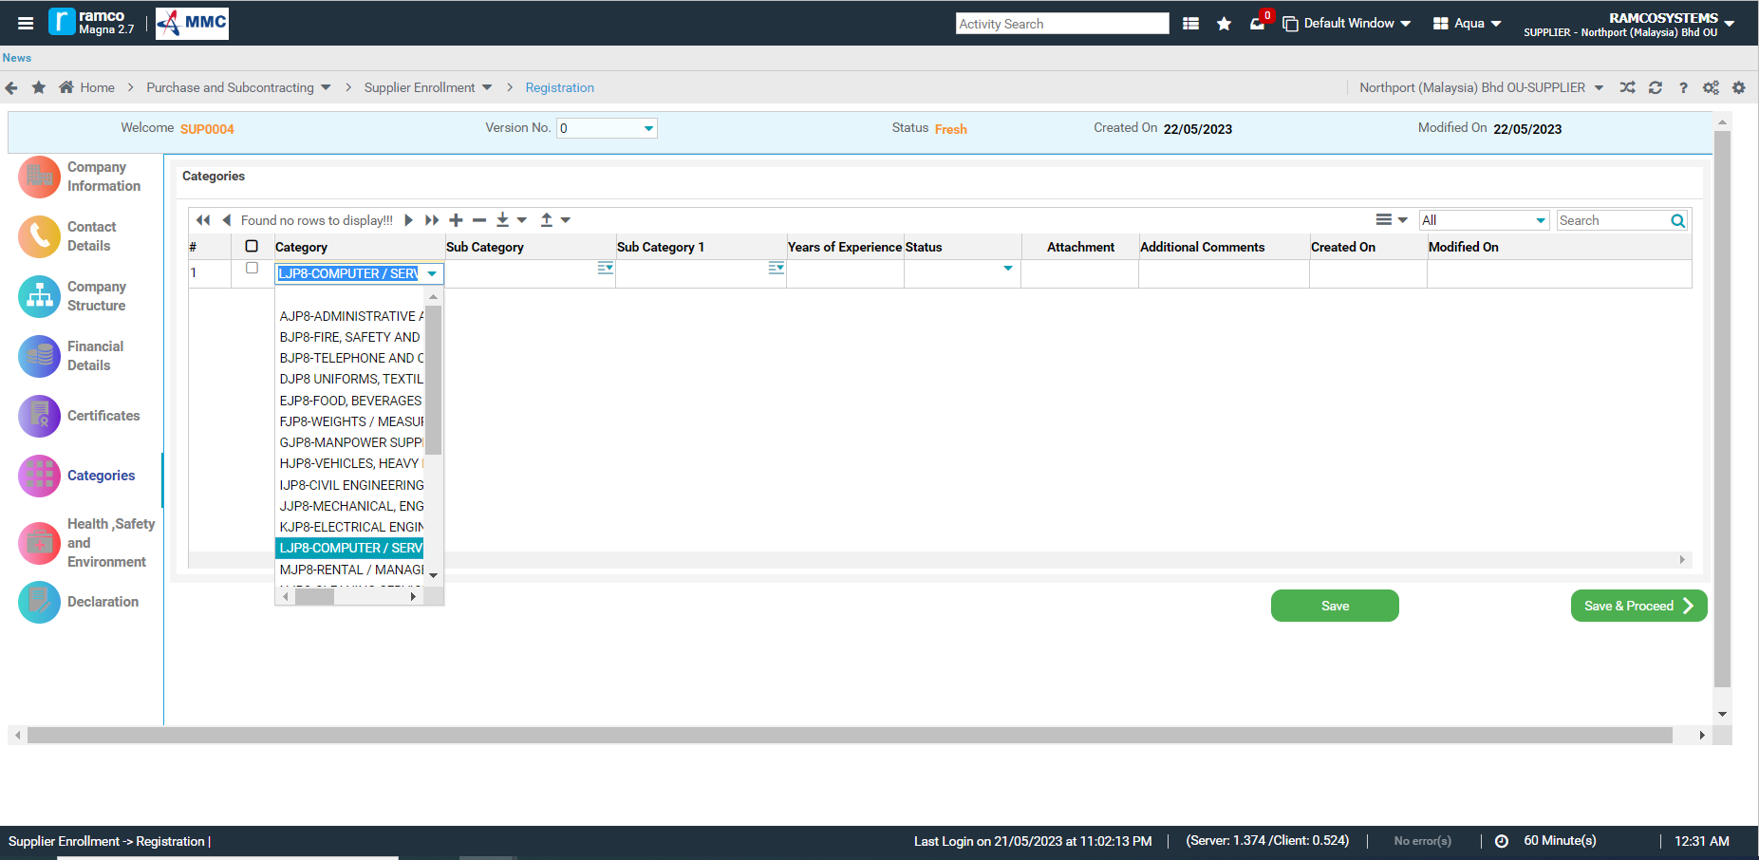
Supplier Registration
Supplier Category should be selected depending on the type of supplier and the goods or services offered.

Slide 38
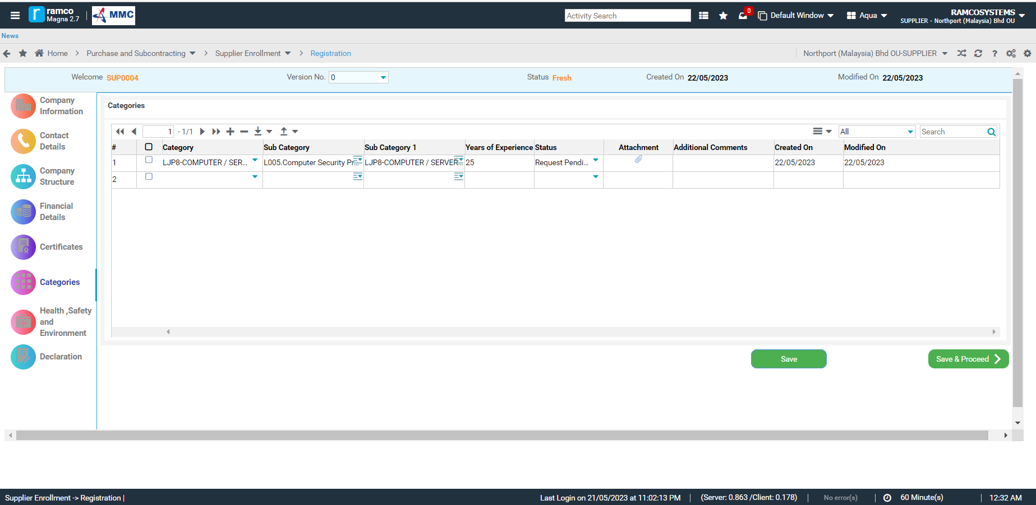
Supplier Registration
- Sub Category and Sub Category 1 are mapped to the selected Category.
Years of experience should be indicated also. Leave Status as blank, as this will be system generated.
Click on SAVE & PROCEED to continue.
Categories need to be specified

Slide 39
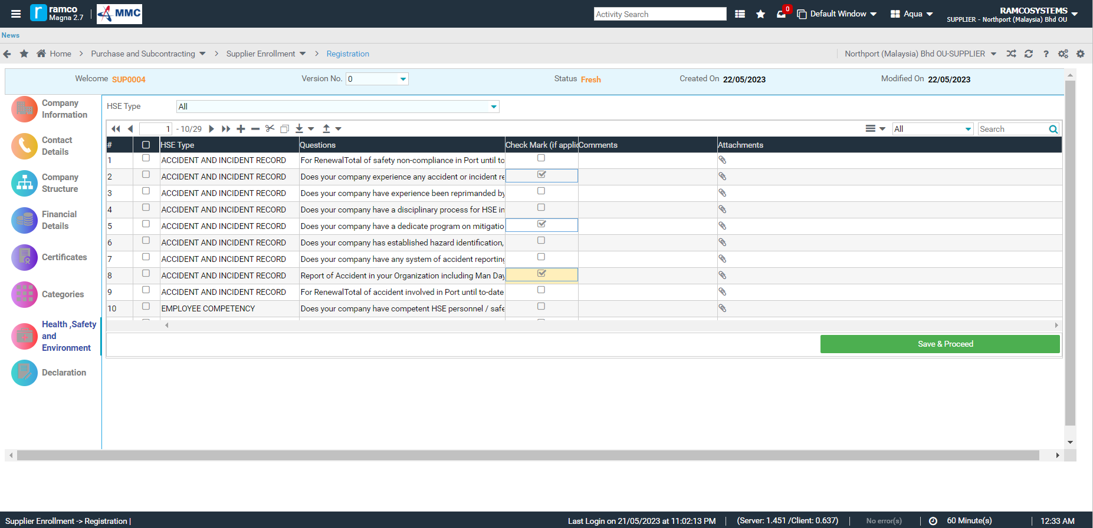
Supplier Registration
Please read and carefully answer the Health, Safety and Environment Questions.
If applicable, please check the corresponding checkbox. Otherwise, leave unchecked.
Comments and Attach facility is also available to support each questions.
This will help the HSE department to properly evaluate the registration application.
Then click on SAVE & PROCEED to save and continue.
Health & Safety details

Slide 40
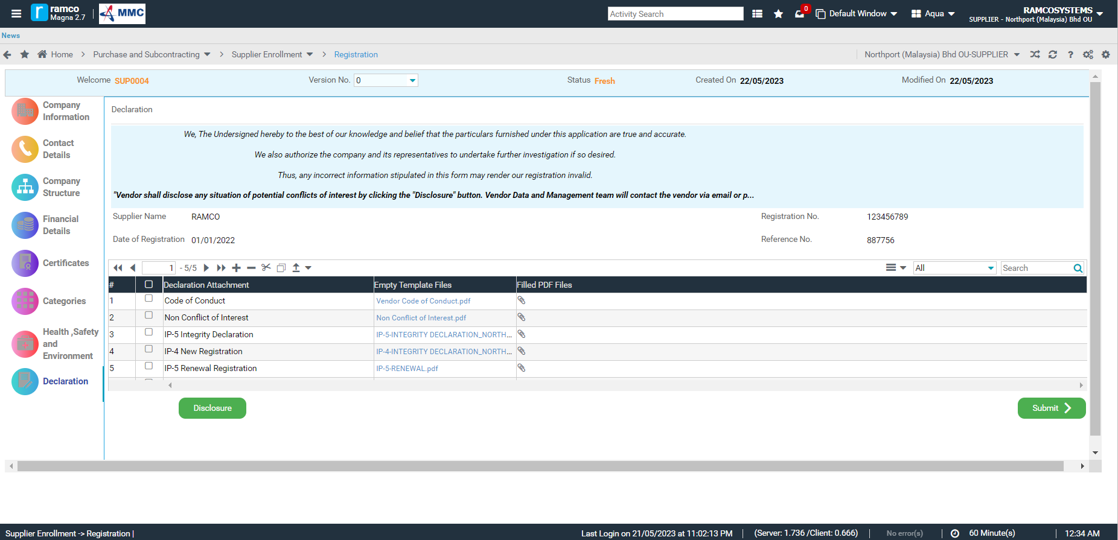
Supplier Registration
Declaration templates are available for download.
Fill up the Declaration forms at attached the Filled PDF Files.

Slide 41
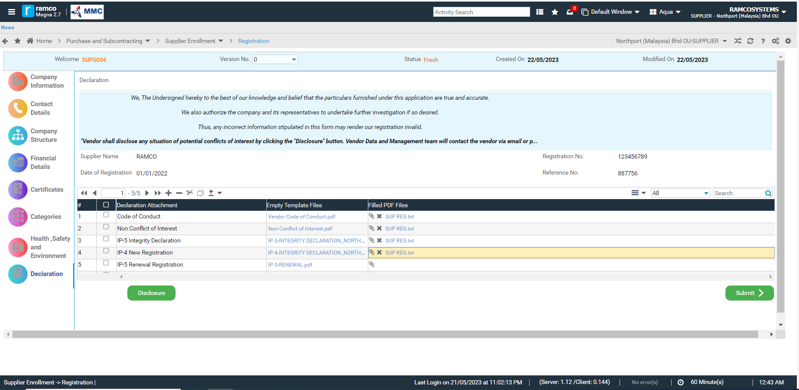
Supplier Registration
If there are potential conflict of interest, please click on DISCLOSURE button and system will notify Vendor Management and they will contact you to assist on the concern.
Then click on SUBMIT to send the Registration Application to Vendor Management.
Final Declaration before submission

Slide 42
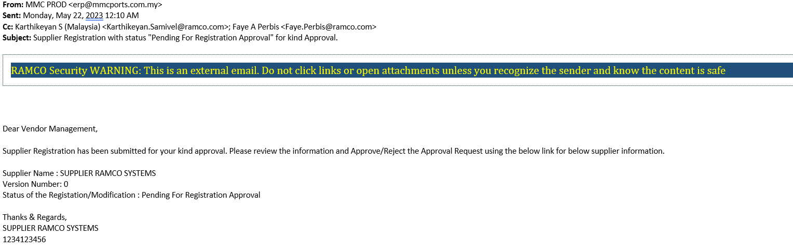
Supplier Registration
After Submission, vendor management Team will receive email notification regarding the registration application. Sample email as below.
Vendor management will then check on the completeness of documents and all requirements.
Vendor Registration will go through approval of different internal departments like HSE, User Department, Finance and Procurement.
Email received

Slide 43
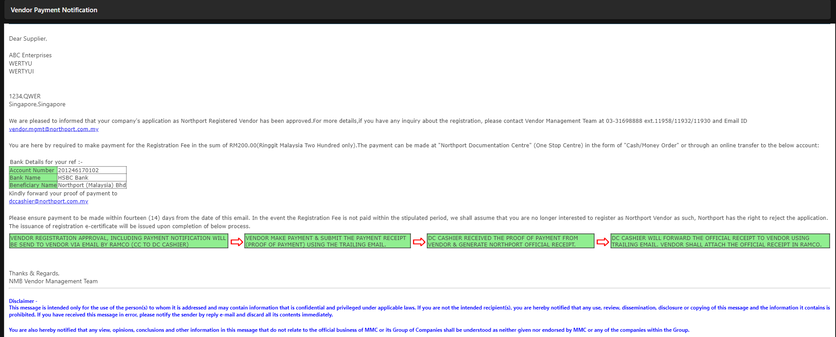
Supplier Registration
Once approved, Vendor management will notify Supplier on the payment process for Registration Fee.
Please refer below sample email of Payment Notification.
Email received

Slide 44
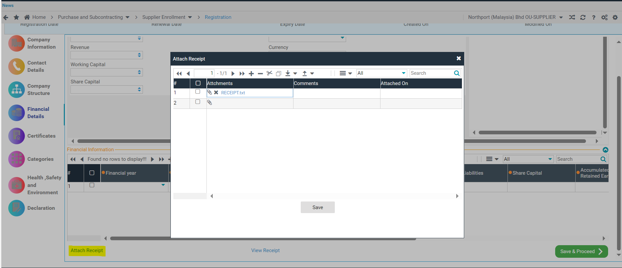
Supplier Registration
Once payment is done, submit the Receipt via Supplier Registration portal.
Click on Attach Receipt, attach the file and click on SAVE.
Purchase and Subcontracting > Supplier Enrollment > Supplier Registration > Financial Details >Attach Receipt
Click to attach Receipt

Slide 45
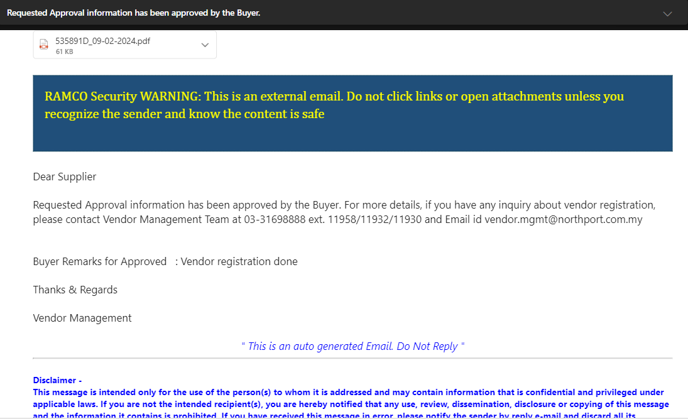
Supplier Registration
Once payment is done, Vendor management will initiate the Final Approval and system will notify vendor via mail together with the Registration Certificate.
Email received

Slide 46
SUPPLIER REVISION
(For Existing Registered Supplier and Rejected Supplier)

Slide 47
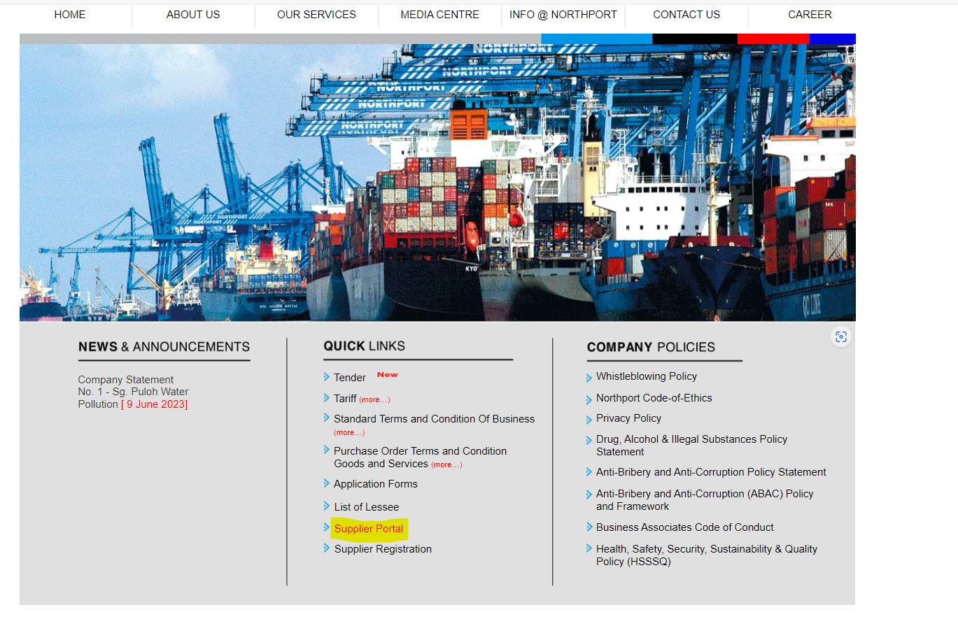
SUPPLIER LOGIN
– Go to MMC-Northport official website (Home (northport.com.my)
– Under Quick Links, click on Supplier Portal. You will be directed to the official Supplier Portal of Northport

Slide 48
Supplier Login
- Enter the Username and Password.
Login with the details

Slide 49
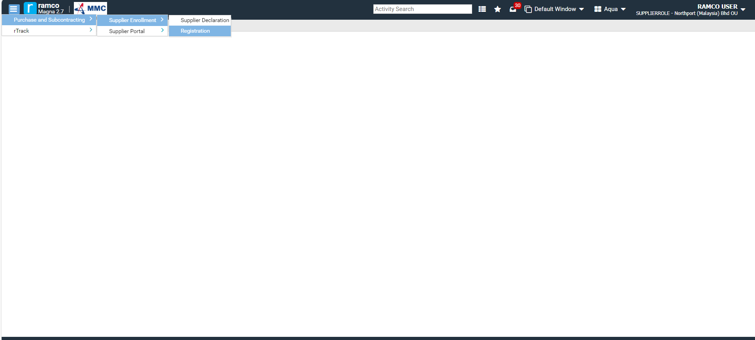
Supplier Revision
(For Existing Registered Supplier (migrated) only)
Purchase and Subcontracting > Supplier Enrollment > Supplier Declaration
Once all MMC Declaration statements are carefully responded, please click on SUBMIT button.
System will ask you to Logout and Login to proceed with the registration.

Slide 50
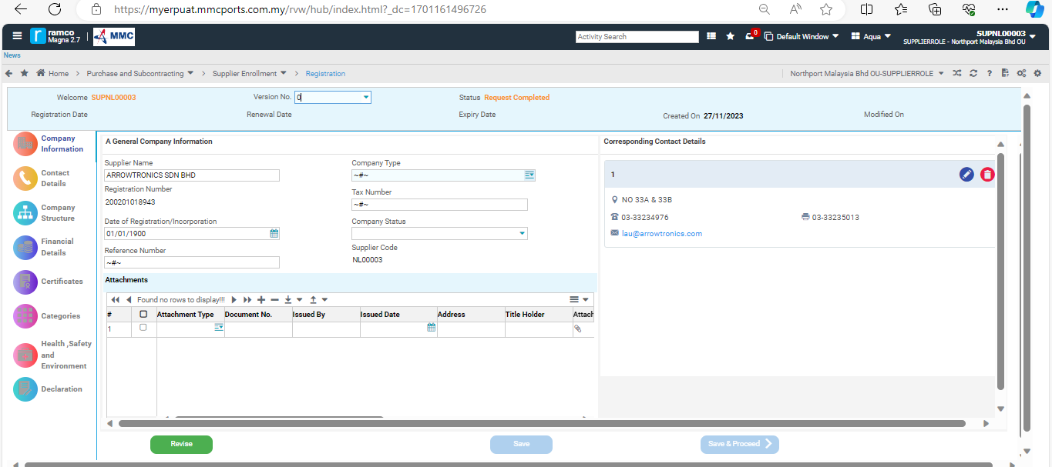
Supplier Revision
(For Existing Registered Supplier and Rejected Supplier)
In case if the registration is rejected or any data the supplier wants to revise, click on the Revise button to initiate the revision process.
Click Revise Button to initiate revision process

Slide 51
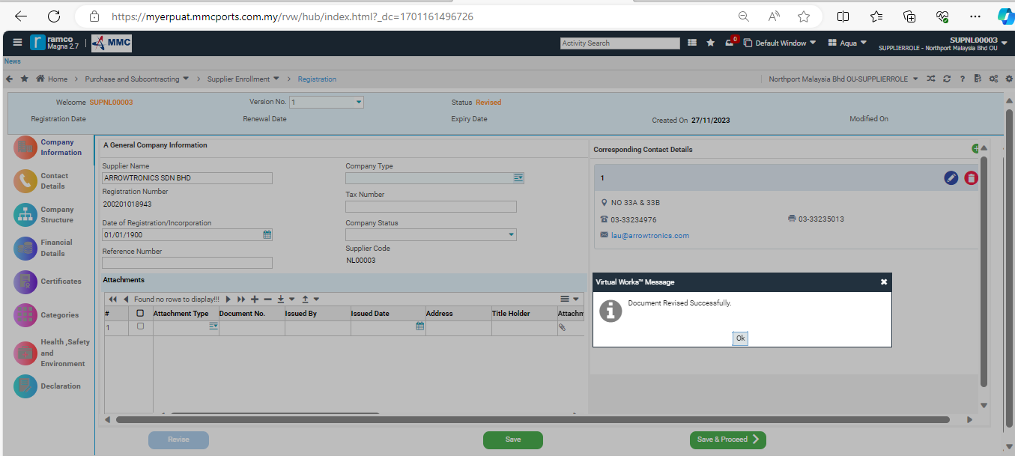
Supplier Revision
Revision is initiated.
Revision of document is initiated.

Slide 52
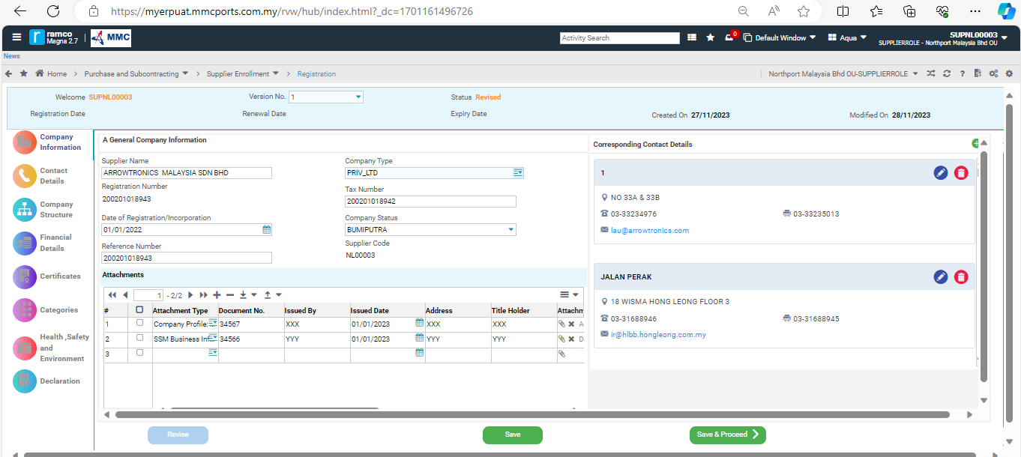
Supplier Revision
Update Company Information as required and click on Save & Proceed.

Slide 53
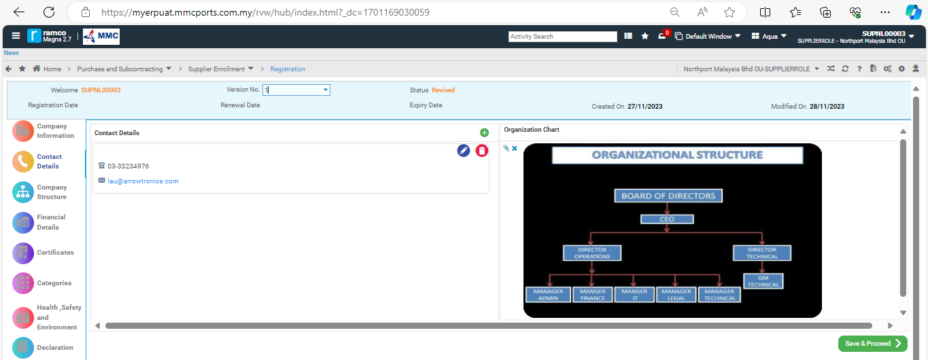
Supplier Revision
Update the Contact Details and attach Organization Chart (image format only), by clicking on the Attach icon to select/browse file to attach.
Click on SAVE & PROCEED.
Note: If Organization Chart is in PDF or any format other than Image formats, please attach the Org. Chart in Company Information-Attachments.

Slide 54
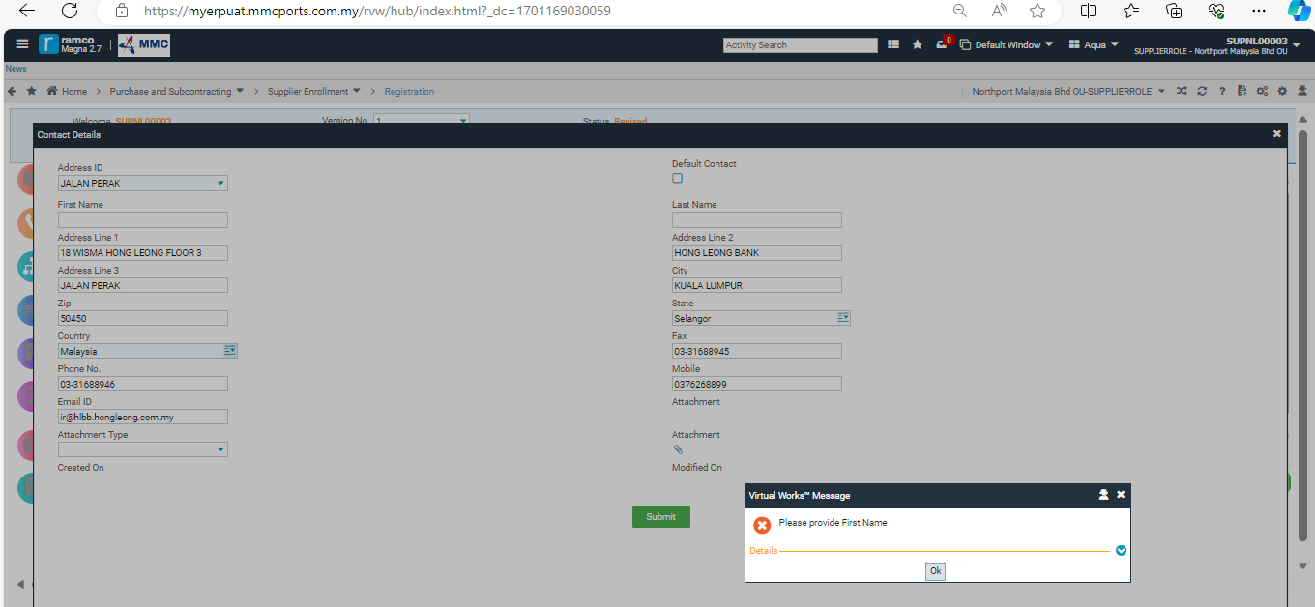
Supplier Revision
Update Contact Details as required and click on Save & Proceed.

Slide 55
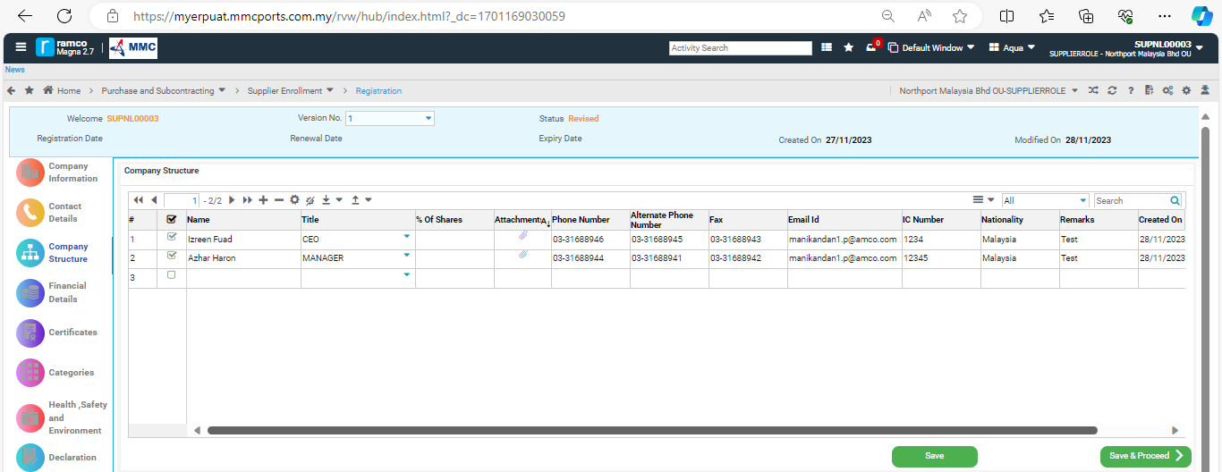
Supplier Revision
Update Company Structure as required and click on Save & Proceed.

Slide 56

Supplier Revision
Update Financial Details as required and click on Save & Proceed.

Slide 57

Supplier Revision
Update Certificates as required and click on Save & Proceed.

Slide 58

Supplier Revision
Update Categories as required and click on Save & Proceed.

Slide 59

Supplier Revision
Update Health, Safety and Environment as required and click on Save & Proceed.

Slide 60

Supplier Revision
Update Declaration details as required and click on Save to save the updates.
Then click on SUBMIT to send the Revision to Vendor Management for approval.

Slide 61
Supplier Registration
Once approved, Vendor management will notify Supplier on the payment process for Registration Fee.
Please refer below sample email of Payment Notification.
Email received

Slide 62
Supplier Registration
Once payment is done, submit the Receipt via Supplier Registration portal.
Click on Attach Receipt, attach the file and click on SAVE.
Purchase and Subcontracting > Supplier Enrollment > Supplier Registration > Financial Details >Attach Receipt
Click to attach Receipt

Slide 63
Supplier Registration
Once approved, system will notify vendor via mail together with the updated Registration Certificate.
Email received

Slide 64
SUPPLIER RENEWAL

Slide 65

Supplier Renewal
Once registration is near the expiration, system will notify supplier via mail notification sent every 30 days, 60 days, 90 days before expiry date.
Email received.

Slide 66
SUPPLIER Renewal
– Go to MMC-Northport official website (Home (northport.com.my)
– Under Quick Links, click on Supplier Portal. You will be directed to the official Supplier Portal of Northport

Slide 67
Supplier Renewal
- Enter the Username and Password.
Login with the details

Slide 68
Supplier Renewal
Purchase and Subcontracting > Supplier Enrollment > Supplier Registration

Slide 69

Supplier Renewal
Once registration is already expired, vendor should initiate the renewal process by clicking the RENEWAL button.
Then click on YES to proceed.
Click Renewal Button to initiate renewal process

Slide 70

Supplier Renewal
Click OK to proceed.

Slide 71

Supplier Renewal
Update the Company Information and attached updated files as required to proceed with the renewal.
Once updated, click on Save & Proceed button to continue with the renewal process.

Slide 72

Supplier Renewal
Update the Contact Details and attach Organization Chart (image format only), by clicking on the Attach icon to select/browse file to attach.
Click on SAVE & PROCEED.
Note: If Organization Chart is in PDF or any format other than Image formats, please attach the Org. Chart in Company Information-Attachments.

Slide 73

Supplier Renewal
Update the Company Structure and attached updated files as required to proceed with the renewal.
Once updated, click on Save & Proceed button to continue with the renewal process.

Slide 74

Supplier Renewal
Update the Financial Details and attached updated files as required to proceed with the renewal.
Once updated, click on Save & Proceed button to continue with the renewal process.

Slide 75

Supplier Renewal
Update the Certificates and attached updated files as required to proceed with the renewal.
Once updated, click on Save & Proceed button to continue with the renewal process.

Slide 76

Supplier Renewal
Update the Categories and attached updated files as required to proceed with the renewal.
Once updated, click on Save & Proceed button to continue with the renewal process.

Slide 77

Supplier Renewal
Update the Health, Safety and Environment and attached updated files as required to proceed with the renewal.
Once updated, click on Save & Proceed button to continue with the renewal process.

Slide 78

Supplier Renewal
Update Declaration details as required and click on SAVE to save the updates.

Slide 79

Supplier Renewal
Update Declaration details as required and click on SAVE to save the updates.
Then click on SUBMIT to send the Revision to Vendor Management for approval.

Slide 80
Supplier Registration
Once approved, Vendor management will notify Supplier on the payment process for Registration Fee.
Please refer below sample email of Payment Notification.
Email received

Slide 81
Supplier Registration
Once payment is done, submit the Receipt via Supplier Registration portal.
Click on Attach Receipt, attach the file and click on SAVE.
Purchase and Subcontracting > Supplier Enrollment > Supplier Registration > Financial Details >Attach Receipt
Click to attach Receipt

Slide 82
Supplier Renewal
Once approved, system will notify vendor via mail together with the updated Registration Certificate.
Email received

Slide 83
Thank You

